Slide 1
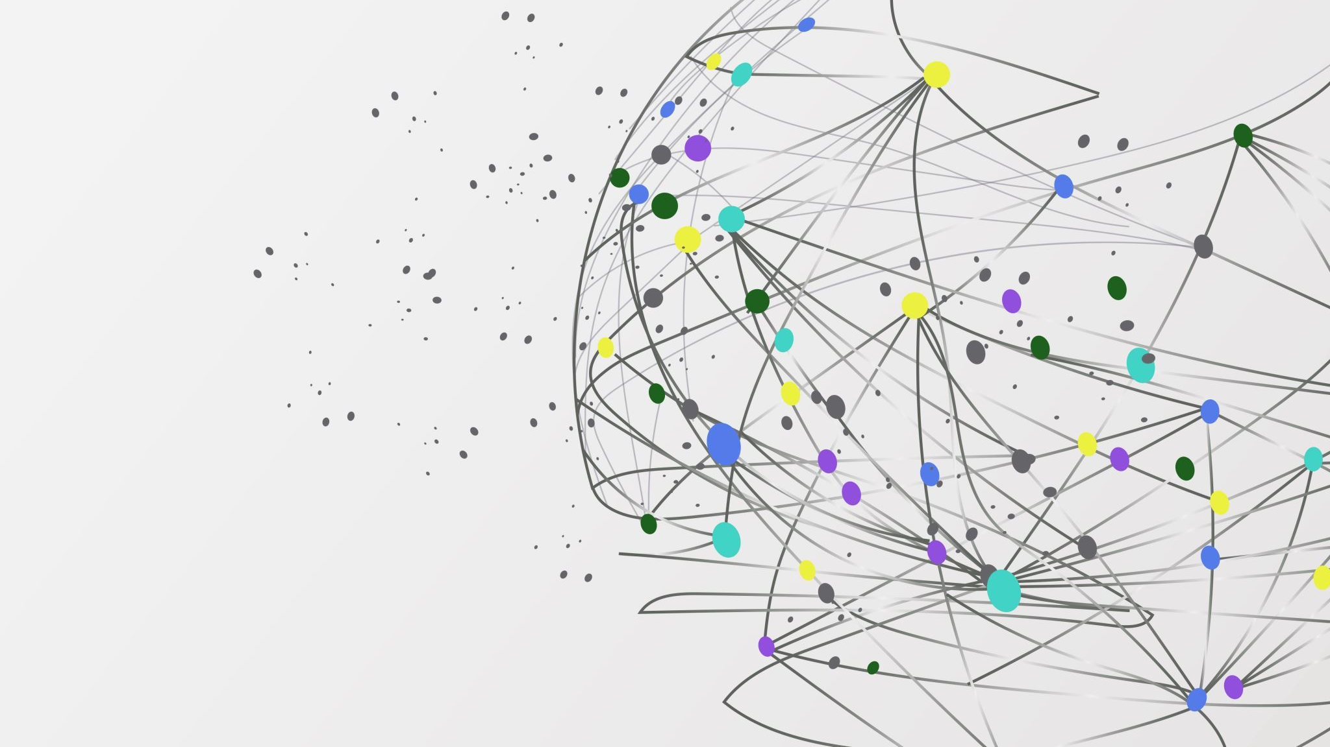
Science 10
Learning Guide 9
Potential and Kinetic Energy

Slide 2
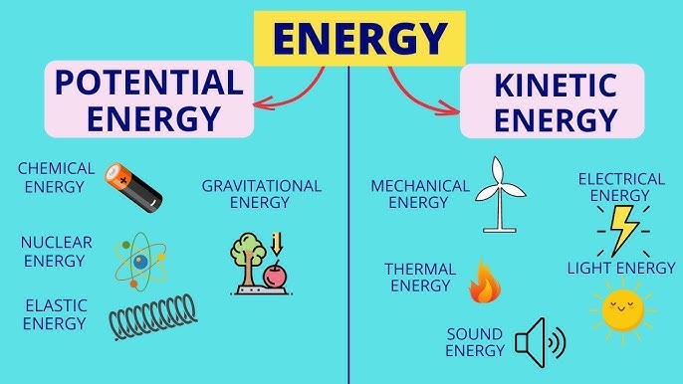
Most of the types of energy can be classified as Potential or Kinetic Energy
Potential Energy – Stored energy, which can describe situations where energy builds up in one place.
Kinetic Energy – Energy that is being used for motion in our world. The motion can be physical objects moving, or particles/waves moving, like a wave of light.

Slide 3
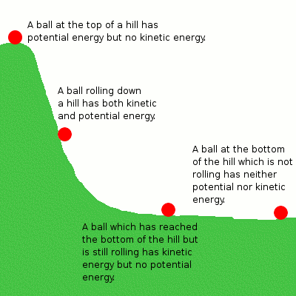
Stored, potential energy can be converted in kinetic, movement energy
In this example, the ball has stored up energy at the top of the hill in the form of the gravitational energy stored when bringing it to the top of the hill.
This energy probably came from the chemical energy human muscles use.
At the top of the hill, there is only potential energy, and no kinetic energy (until it begins rolling down the hill).

Slide 4
Stored, potential energy can be converted in kinetic, movement energy
When the ball is rolling down the hill, the gravitational energy (potential) is being converted into Kinetic energy, as the ball will accelerate, moving faster and faster.
The further down the hill, the more potential energy will have been "lost" to Kinetic energy (and in the real world, other forms of energy like heat from friction).

Slide 5
Stored, potential energy can be converted in kinetic, movement energy
At the bottom of the hill (height = 0 m), there will no longer be any potential energy left. All the potential energy will have been converted into kinetic energy.
The ball will eventually stop, as the kinetic energy will be converted into heat from friction.
Interestingly, if friction (and maybe sound) did not exist, the ball would roll forever.

Slide 6
Calculating Potential Energy with our good friend, math!
E_{p} = mgh
Potential energy can be found by multiplying
  The mass (in kilograms) of the object by
  The height (in meters) of the object by
  The gravity (in meters per second squared) from the planet's pull
The formula on the right shows this formula.
Energy has multiple units, but by using this formula in the described way, you will find the joules of energy.
On Earth, gravity is always 9.8 m/s². Other planets will be different.
Joules (J)
Kilograms (kg)
Meters (m)
Meters per second squared (m/s²)

Slide 7



Example Questions for Potential energy
1) If an apple has a mass of 0.250 kg and is moved onto a shelf that is 2 meters off the ground, how much potential energy does the apple have stored?
E_{p} = mgh
E_{p} = (0.250 kg)(9.8 m/s²)(2 m) = 4.9 J of energy
Sometimes questions will ask for answers that require you to rearrange the formula using algebra.
2) If a banana with a mass of 0.10 kg has 3.9 J of potential energy on a surface, how high up is the surface off the ground?
E_{p} = mgh Rearrange by dividing each side by m and g to get h alone.

Slide 8

Calculating Kinetic Energy with our good friend, math!
E_{k} = mv²
Kinetic energy can be found by multiplying
  A half (0.5) by
  The mass (in kilograms) of the object by
  The velocity/speed (in meters per second) SQUARED.
The formula on the right shows this formula.
Energy has multiple units, but by using this formula in the described way, you will find the joules of energy.
Remember that velocity is squared, it is the easiest thing to forget!
Kilograms (kg)
Joules (J)
Meters per second (m/s)

Slide 9


Example Questions for Kinetic energy
1) If a 0.8 kg ball is rolling at the bottom of a hill with a velocity of 5 m/s, how much kinetic energy does it have? (remember, BEDMAS means you square the velocity first!)
K_{E} = mv² K_{E} = (0.8 kg)(5m/s)² K_{E} = (0.8 m)(25m²/s²) K_{E} = 10 J
2) If a 60 kg skier makes it to the bottom of a hill and has 1920 J of kinetic energy, how fast is the skier moving?
E_{k} = mv² Rearrange by first multiplying each side by 2 to move the half to the other side.
2E_{k} = mv² Rearrange by dividing each side by m, leaving v² alone.
= v² Get v alone be square rooting each side to remove the square from v.
E_{k}
(1920 J)
8 m/s
(60 kg)

Slide 10
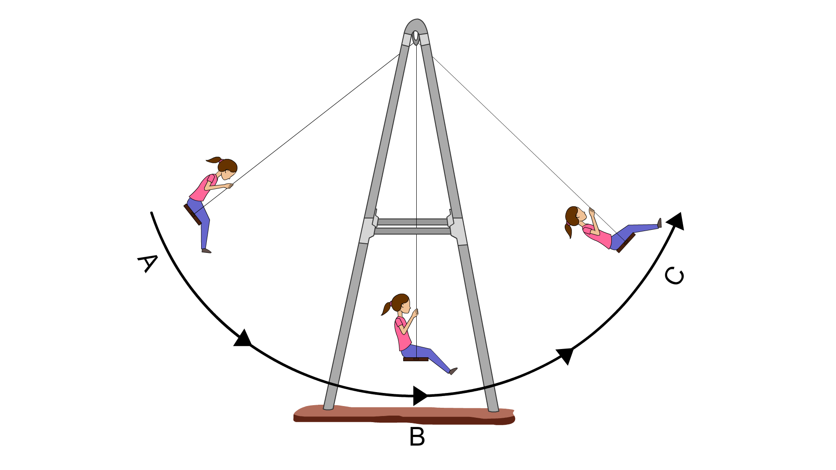
Sample questions
a) If a 45 kg person swings on a swing set and reaches a maximum height of 2 meters off the ground, how fast do they move at the bottom of their swing (when height = 0 m)?
Start by finding their potential energy at the top of the swing (point A):
E_{p} = mgh
E_{p} = (45 kg)(9.8 m/s²)(2 m)
E_{p} = 882 J
Mass of humanoid entity: 45 kg
2 m

Slide 11
Sample questions
a) If a 45 kg person swings on a swing set and reaches a maximum height of 2 meters off the ground, how fast do they move at the bottom of their swing (when height = 0 m)?
When the person is at the lowest point their potential energy has been converted to other forms of energy (since h is 0 m, there no potential energy left). This means that in a perfect world, all energy is converted to kinetic energy, leading to the speed at the bottom. Let's use the formula we previously rearranged to calculate the speed of the swing.
Mass of humanoid entity: 45 kg
2 m
E_{k}
(882 J)
6.26 m/s
(45 kg)

Slide 12
Sample questions
b) Due to real world factors, the person only achieves a speed of 5 m/s. If this speed was achieved at the bottom of the swing and all the energy is converted back into potential energy going up to point C, how high will the person reach on the forward swing?
Mass of humanoid entity: 45 kg
Use the real speed to find their actual kinetic energy at point B.
E_{k} = mv²
E_{k} = (45 kg)(5 m/s)²
E_{k} = (45 kg)(25 m²/s²) = 562.5 J
2 m
?

Slide 13
Sample questions
b) Due to real world factors, the person only achieves a speed of 5 m/s. If this speed was achieved at the bottom of the swing and all the energy is converted back into potential energy going up to point C, how high will the person reach on the forward swing?
Mass of humanoid entity: 45 kg
We are assuming that all of this kinetic energy is converted into potential energy for the forward swing. Use the formula we previously rearranged to find the height of the swing.
h = = 1.28 m,
(562.5 J)
which is 0.72 m less than where the person started at point A!
2 m
?
(45 kg)
(9.8 m/s)

