Slide 1
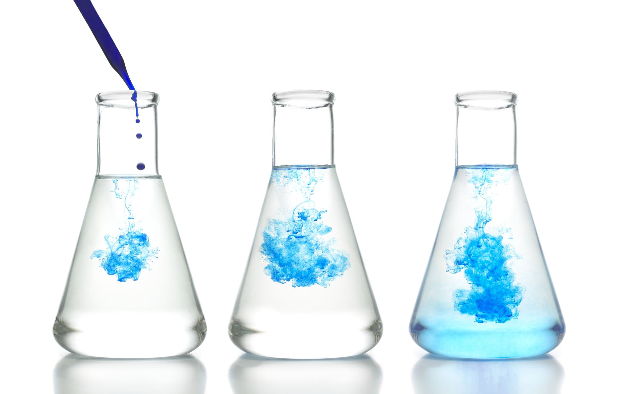
Chemical Reactions and Balancing
Make sure to practice this learning guide!

Slide 2
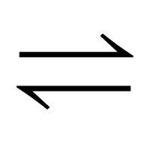
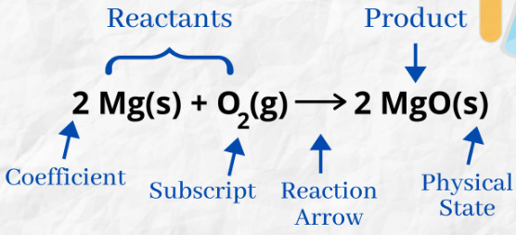
What reaction equations look like
Vocabulary:
Reactants – Substances that are reacting at the start. They are always on the left side of a chemical equation.
Products - Substances that are produced from a reaction. They are always on the right side of a chemical equations.
Produces – We never say or use "equals" because the reactants and changing and producing something new. Instead, we use an arrow, like this:
Sometimes we use two arrows if the reaction is going both ways: Don't worry about this arrow, this is just here in case you run across it.
The states of matter are also usually given in the bottom right of each chemical as subscripts in brackets, where: aq means aqueous (in water), l means liquid, s means solid, and g means gas.
Example Reaction – Reactions will usually look something like this. Notice the arrow and the chemicals on each side.

Slide 3
Types of Reactions
1. Synthesis (S) – When two or more chemical substances react and form a single product.
General Form:
Example:
2. Decomposition (D) – When 1 chemical substance breaks down into two or more products.
General Form:
Example:
A + B
AB
AB
A + B

Slide 4
Types of Reactions
3. Single Replacement (SR) – When one element takes the place of another after two substances react. There will still be two substances as products, and metal will usually replace a metal and a non-metal will usually replace a non-metal.
General Form:
Example:
4. Double Replacement (DR) – When two substances swap either the metal or the non-metal. This will always start with two ionic compounds and produce two substances with recombined elements.
General Form:
Example:
A + BC
B + AC
or
C + AB
A + BC
(Zinc metal)
(Copper Sulphate)
(Zinc Sulphate)
(Copper metal)
AB + CD
AD + CB

Slide 5
Types of Reactions
5. Neutralization (N) – A special double replacement reaction. This always involves an acid reacting with a basic substance. This always produces water and a salt made of the metal from the base and the non-metal from the acid.
General Form:
Example:
6. Combustion (C) – When a fuel source is burned, it reacts with O₂ gas. This reaction always produces water and carbon dioxide. Light and heat are also produced. Note: x, y, and z are numbers that depend on the fuel source burned. Sometimes z is 0, meaning there is no oxygen in the fuel.
General Form:
Example:
AOH + HB
H₂O + AB
NaOH + HCl
H₂O + NaCl
(Sodium Hydroxide)
(Hydrochloric Acid)
(Water)
(Sodium Chloride salt)
C_{x}H_{y}O_{z} + O₂
H₂O + CO₂
C₃H₈ + 5 O₂
4 H₂O + 3 CO₂
(Propane)
(Oxygen Gas)
(Water)
(Carbon Dioxide)

Slide 6
Balancing each type of reaction
The Law of Conservation of matter: Matter cannot be created or destroyed.
Because of this law, every element that reacts must be on the products side in equal amounts.
To balance equations, we cannot alter the subscripts, as it will cause changes to the actual substances. Instead, we put numbers in front of compounds, called coefficients (just like in math).
A coefficient multiplies the number of every element in the compound. Example:
In this example, there would be 3x1=3 Magnesium, 3x1=3 Carbons and 3x3=9 Oxygens.
All compounds have an invisible "1" in front of them to start.
Coefficients are never written as fractions or decimals.
3 MgCO₃

Slide 7
Balancing reactions
There are many strategies to balancing reactions. None are required, but greatly help.
Use pencil. You need to edit a lot and sometimes retry.
Make a table like the one on the right to keep track of the number of elements on the left and right side.
If a polyatomic ion appears on both sides, count it as one unit (do not break it up).
Try starting with element/polyatomic that is most unbalanced.
For this example, we need to add a 2 in front of sodium hydroxide to make each side equal.
NaOH + MgSO₄
Na₂SO₄ + Mg(OH)₂
(Sodium hydroxide)
(Magnesium Sulphate)
(Sodium Sulphate)
(Magnesium Hydroxide)
Reactants |  | Products
Na | 1 | Na | 2
OH⁻ | 1 | OH⁻ | 2
Mg | 1 | Mg | 1
SO₄ | 1 | SO₄ | 1

Slide 8
Balancing reactions- Neutralization
For neutralization, you need to break down the OH, because it is combining with the hydrogen on the acid to form water.
Start by balancing the salt and leave the water until last.
Example order: Orange writing to balance the salt, then green writing to balance the water.
Al(OH)₃ + HCl
H₂O + AlCl₃
(Aluminum Hydroxide)
(Hydrochloric Acid)
(Water)
(Aluminum Chloride salt)
Reactants |  | Products
Al | 1 | Al | 1
O | 3 | O | 1
H | 3 1 | H | 2
Cl | 1 | Cl | 3

Slide 9
Balancing reactions- Combustion
Combustion is the hardest to balance. Here is a step-by-step balancing trick to get it right in a guided way:
Pretend the fuel source has a 1 in front of it.
Balance the Carbons, there is only 1 reactant (fuel source) and product (CO₂) with carbon.
Balance the Hydrogens, there is only 1 reactant (fuel source) and product (H₂O) with hydrogen.
Add up all the oxygens in products, accounting for the coefficients.
If the fuel source has oxygen, subtract it from the answer in step 4.
Divide the number from step 4 and 5 by 2. Place it in front of the oxygen gas.
If the number for oxygen was a decimal/fraction, multiply all coefficients by 2.

Slide 10
Balancing reactions- Combustion
Combustion example:
Step 1: Red, Step 2: Blue, Step 3: Green, Step 4: Purple, Step 5: Orange, Step 6: Pink, Step 7: Lime
C₃H₈O + O₂
H₂O + CO₂
(Propanol)
(Oxygen Gas)
(Water)
(Carbon Dioxide)
Reactants |  | Products
C | 3 | C | 1
H | 8 | H | 2
O | 1 2 | O | 1 2
2 C₃H₈O + 9 O₂
8 H₂O + 6 CO₂
Answer:

Slide 11
Balancing reactions- Given names
Sometimes the reaction is given in only chemical names. If this happens:
Convert the names into formulas using charges or covalent compound prefixes (whichever applies).
Then proceed to balance the equation using only coefficients.
Example:
Silver Nitrate + Copper (II) Chloride
Silver Chloride + Copper (II) Nitrate
Convert to an equation with formulas
AgNO₃ + CuCl₂
AgCl + Cu(NO₃)₂
Balance the equation using coefficients
2 AgNO₃ + CuCl₂
2 AgCl + Cu(NO₃)₂

Slide 12
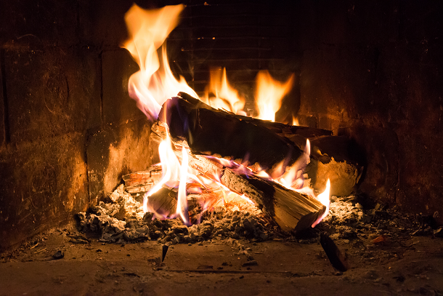
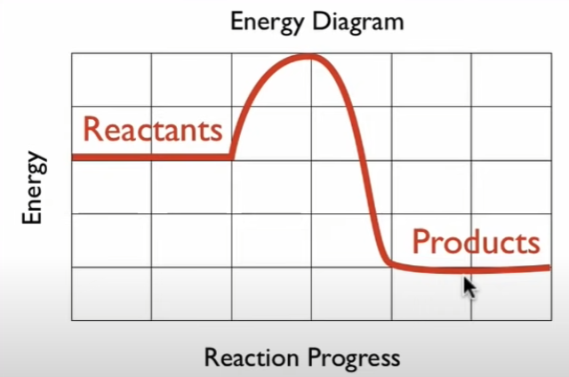
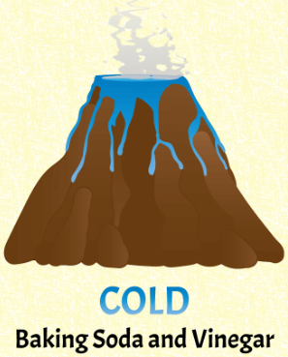
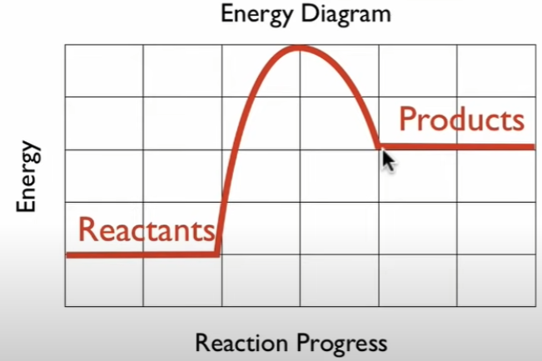
System and Surroundings
The system refers to where the reaction takes place. The surroundings is the area around the system. Example: a reaction takes place in a beaker, with the surroundings being the glass and air.
When a reaction takes place, heat is either released or taken up to allow the reaction to happen. This is because chemical bonds hold energy.
Exothermic
When heat is released, the reaction is called exothermic. This causes the surroundings, like the glass beaker, to get warm/hot.
When heat is taken up, the reaction is called endothermic. This causes the surroundings to get cold.
Endothermic

