Slide 1
Acids, Bases, and Organics
Please note: You do not need to memorize how to name acids and bases, but it can be helpful later if you want to keep going in chemistry.

Slide 2
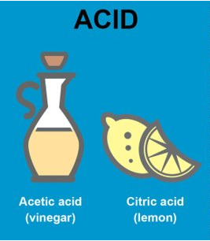
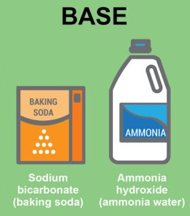
Acids
Bases
The simple definition for a base is a compound that can produce OH⁻ ions (hydroxide ions).
Bases are:
Bitter in taste
Can cause a burning feeling, but also feel slippery
Conduct electricity
Examples include Sodium Hydroxide cleaners (NaOH), Magnesium Hydroxide Mg(OH)₂, and many cleaning products like soap.
The simple definition (by Svante August Arrhenius) for an acid is a compound that contains hydrogen and can produce H⁺ ions.
Acids are:
Sour in taste
Can cause a burning feeling
Corrode metals through reactions
Conduct electricity
Examples: Hydrochloric acid (HCl), battery acid (H₂SO₄), lemon juice, milk...

Slide 3
Acid/Base pH Scale
Acids and bases can be strong, weak, and everywhere in between. To judge their strength, we place them on a pH scale that ranges from 0 to 14 (but can go past those boundaries).
Numbers lower than 7 on the pH scale represents acids, with lower numbers being more acidic.
Numbers higher than 7 on the pH scale represents bases, with higher numbers being more basic.
7 itself is considered neutral, meaning the substance is balanced in terms of how acidic or basic it is. This is typically represented by water.
The scale is logarithmic, meaning every time the number increases or decreases by 1, it represents a 10 times change in how acidic or basic the substance is.

Slide 4
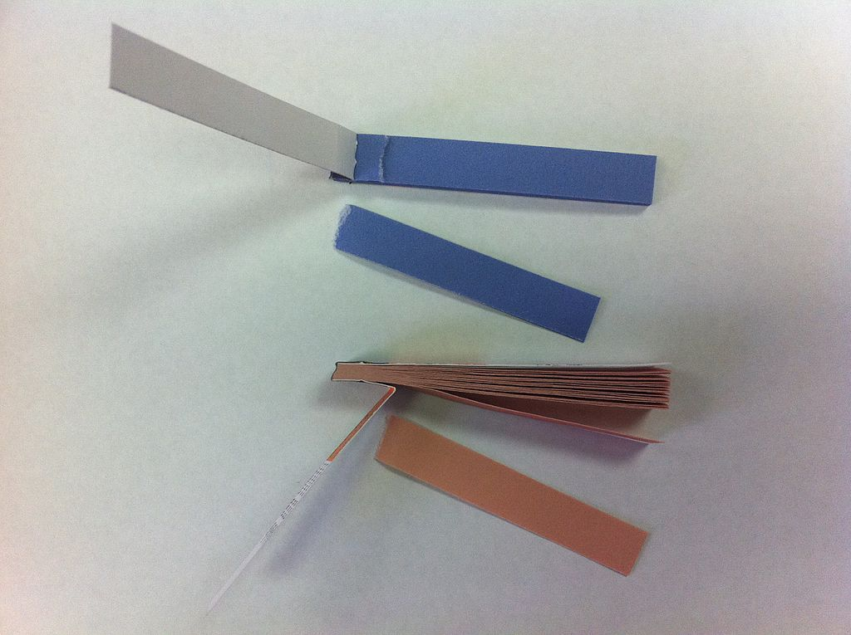
Acid/Base Indicators
To test to see if something is an acid or base, and to test to see the strength of the acid or base, we use indicators. Indicators typically change colour at a specific pH.
One of the best indicators to start with is Litmus paper. Made from lichens (Algae), it changes colour at pH 7. If the paper turns red, the substance is acidic. If the paper turns blue, the substance is basic.

Slide 5
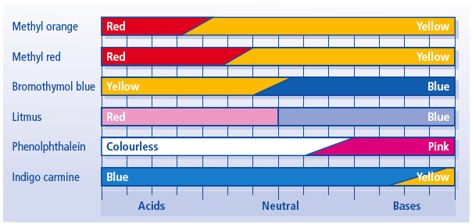
Acid/Base Indicators
We also have access to many other indicators that change colour at other pHs. This can help narrow down what the pH is. For example, if the substance causes:
Litmus to be red
Methyl orange to be yellow
Methyl red to be red
We know the substance will be between about 4 and 5 on the pH scale. This would be moderately acidic.
Note: this chart does not show even a fraction of the indicators available. There are far more.

Slide 6
Acid and Bases - Reactions
If acids and bases are mixed together, they cause a neutralization reaction to occur.
Neutralization reactions always produce a water (when the H⁺ and OH⁻ ions combine) and a salt (using the leftover metal and non-metals).
The type of salt produced always depends on water metals and non-metals went into the reaction.
Example: Hydrogen Chloride (HCl) mixing with Sodium Hydroxide (NaOH)
Acid
Base
Water
Salt
HCl + NaOH
H₂O + NaCl
This particular reaction is producing sodium chloride salt (table salt)
Notice that we use an arrow in the middle to show a reaction, rather than an equals sign. Do not use an equals sign.

Slide 7
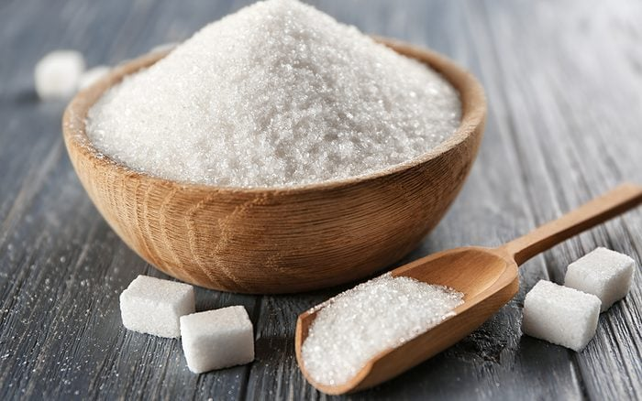
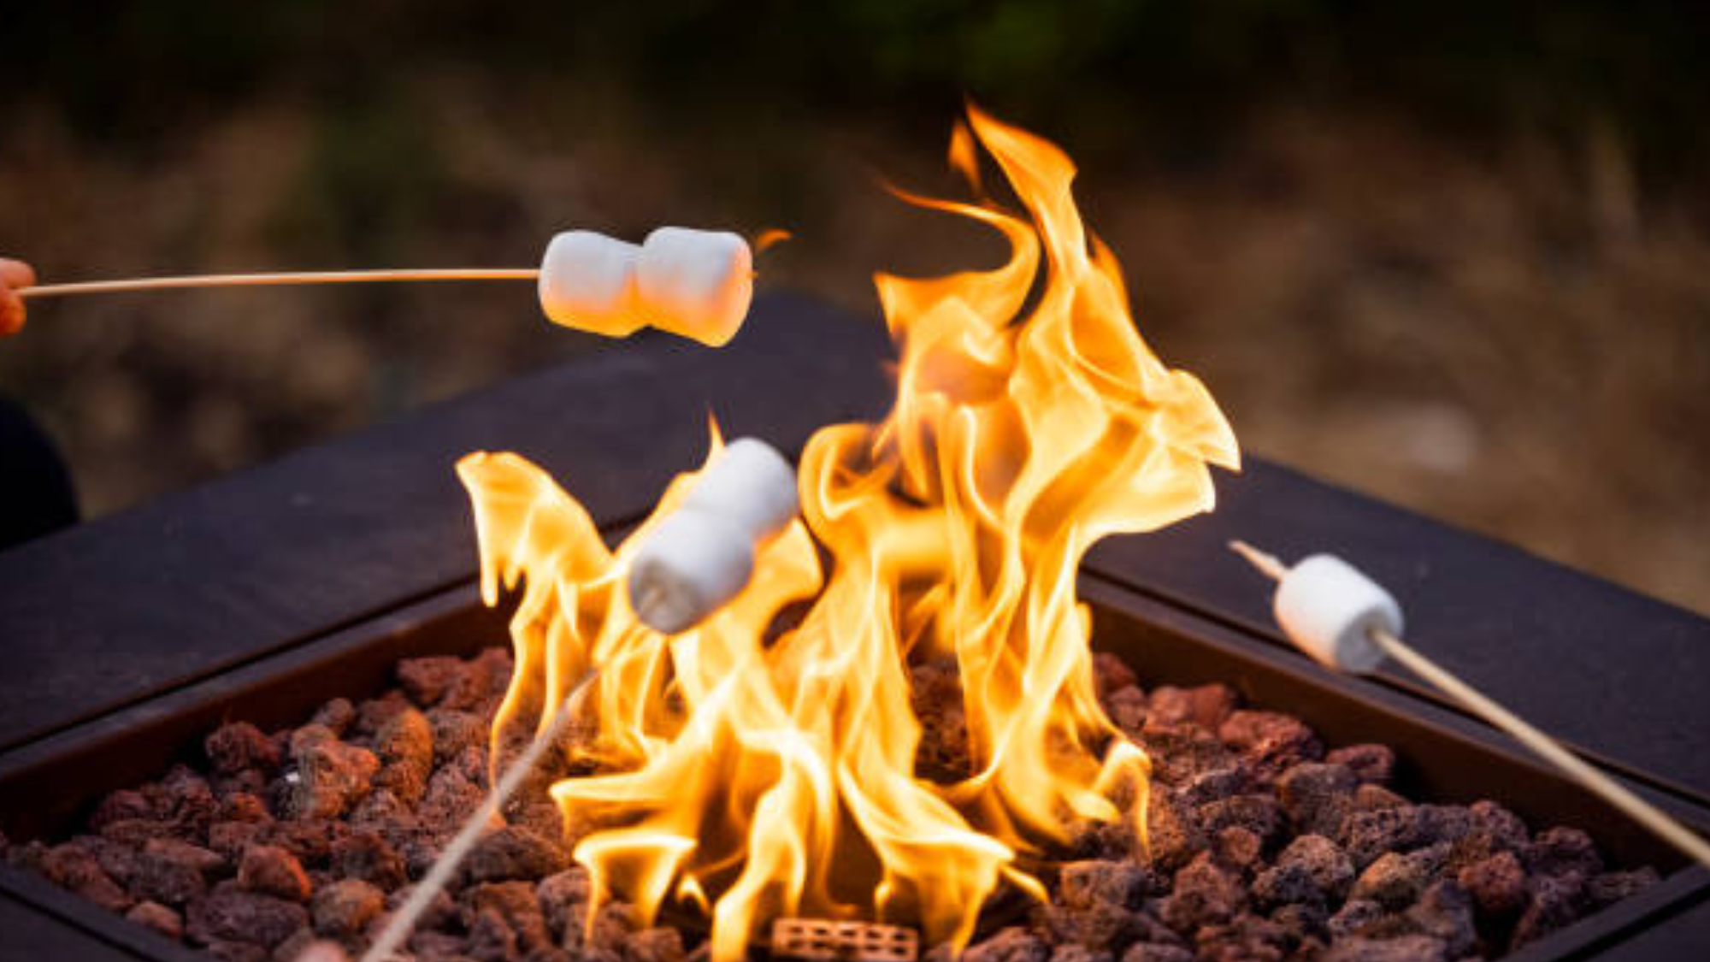
Organic Compounds
Organic compounds are a separate topic from acids and bases, with some overlap.
Organic compounds are chemical compounds where one or more carbon atoms are bound with other non-metal elements, most commonly hydrogen, oxygen, or nitrogen. Typically, they are covalent compounds and share electrons.
To identify at a glance if a chemical is organic, look in the name, structure, or formula for carbon and other non-metals (with some exceptions).
Most organic compounds are flammable and are stored in a way to prevent fires.
All other compounds that are not organic are called inorganic. This typically includes anything with a metal.

Slide 8
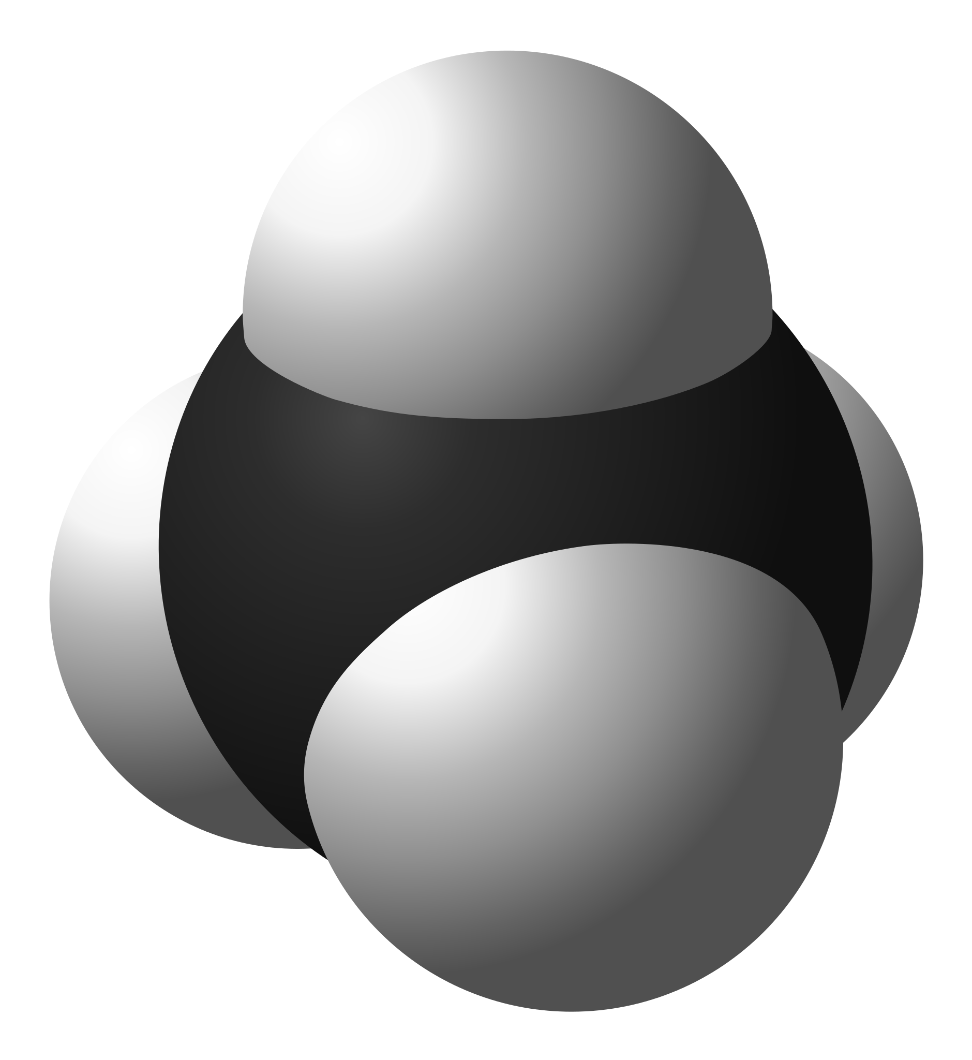
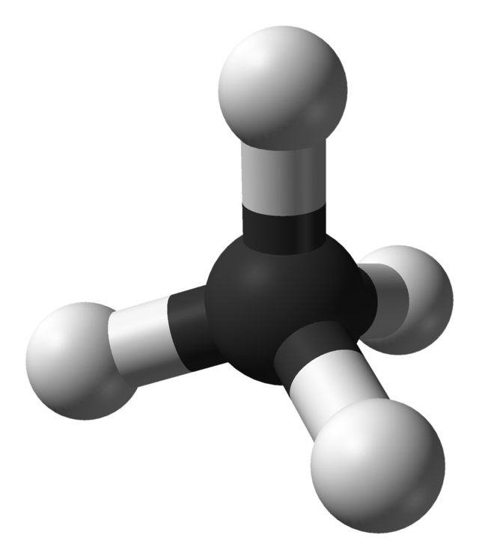
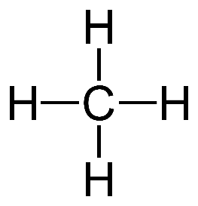
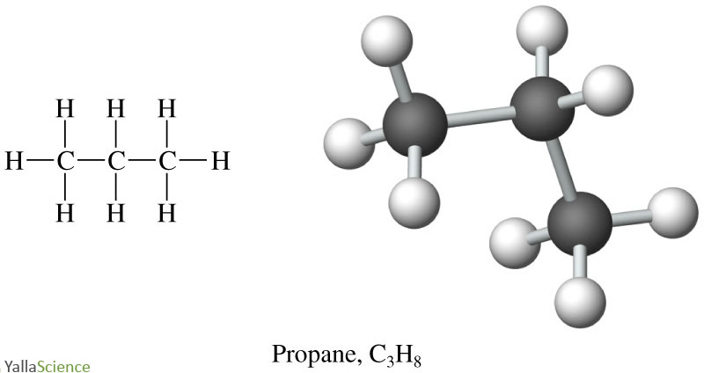
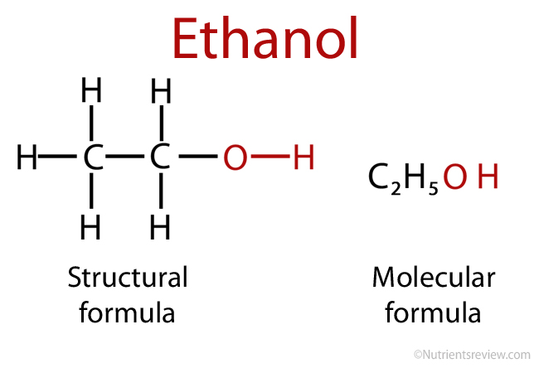
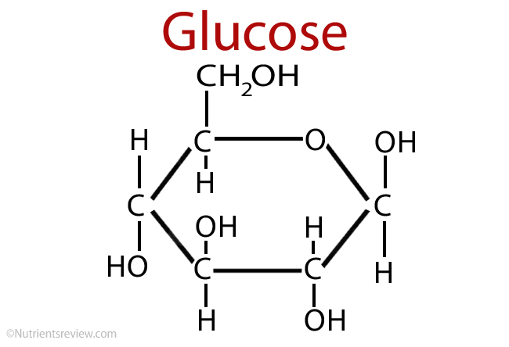
Organic Examples
Methane: 1 Carbon and 4 Hydrogens Molecular formula: CH₄
Space-Filling Model
The atoms take up their full space.
Ball and Stick Model
The atoms are represented by balls, with sticks for the bonds.
Structure Model
The element names are drawn in with lines to show covalent bonds.

Slide 9
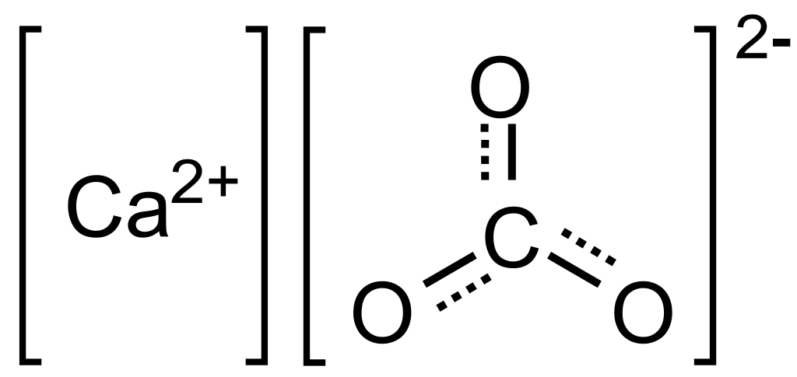
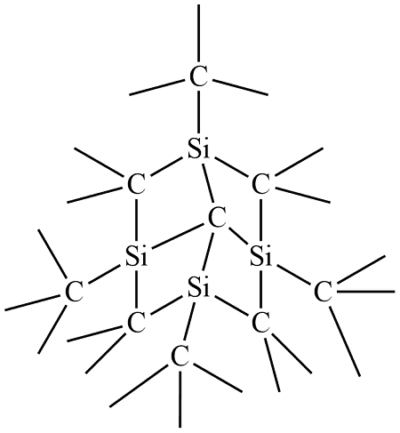
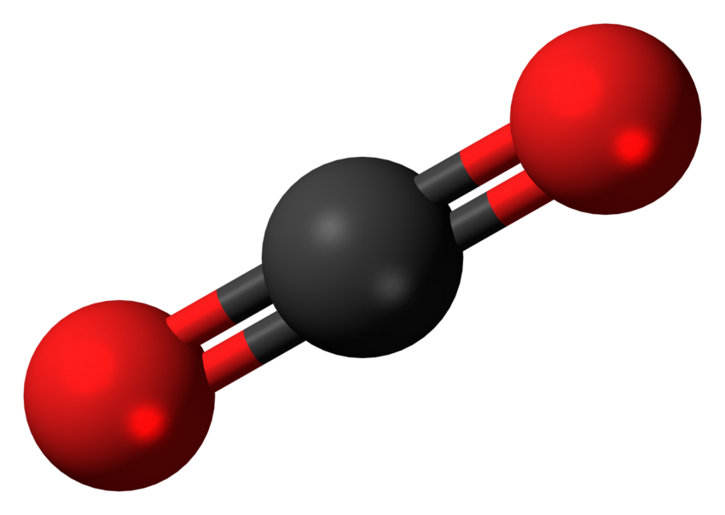
Organic Exceptions
Any of the Carbonates (end in CO₃)
Any of the carbides (typically a metal or semimetal bound to a carbon)
Any oxides (In this case, oxygen bound to just carbon)
Calcium Carbonate:
Silicone Carbide:
Carbon Dioxide:

Slide 10
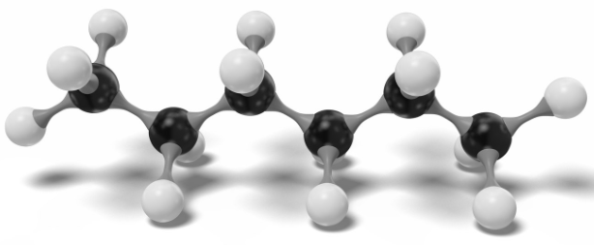
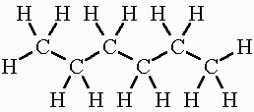
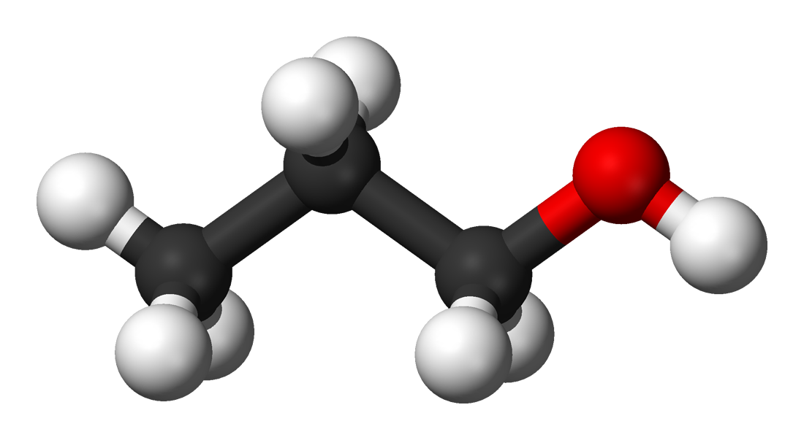
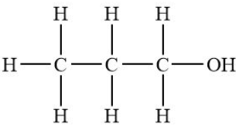
Organic Hydrocarbons and Alcohols
Hydrocarbons are organic compounds that are long chains of only hydrogen and carbon.
Alcohols are many organic molecules that contain a Hydroxyl group (OH⁻) bound to a carbon. There are countless alcohols that exist, with most being toxic.
Hexane:
1-propanol:

