Slide 1
Natural and Artificial Selection

Slide 2
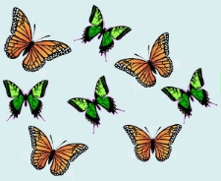
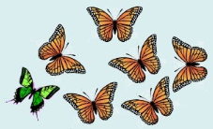
Natural Selection
In the previous learning guide, we learned about how different versions gene/traits (alleles) are inherited
LG15 starts with Natural Selection - The idea that certain traits allow for organisms to survive better than other traits, and are thus "selected" or favoured more by nature.
Favoured individuals are said to be more fit for survival (have a higher fitness). The term "survival of the fittest" means the strongest for survival carry on, the others die out.
In the pictures, Natural Selection has "favoured" the green butterflies more than orange. Perhaps green blends in better and helps avoid being eaten.

Slide 3
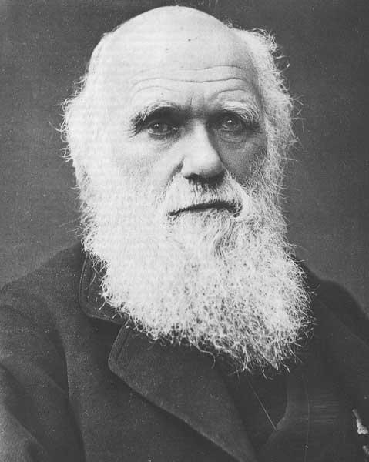
The popularization of Natural Selection
Charles Darwin was the first person credited with research supporting Natural Selection.
Prior to Darwin, there were ideas related to natural selection that were known for a long time, but Charles Darwin popularized the idea and went against the other differing and accepted ideas, such as creationism.
Because his work went against prior thought, it was fiercely rejected.
Charles Darwin: 1809-1882
(Heart Disease)

Slide 4
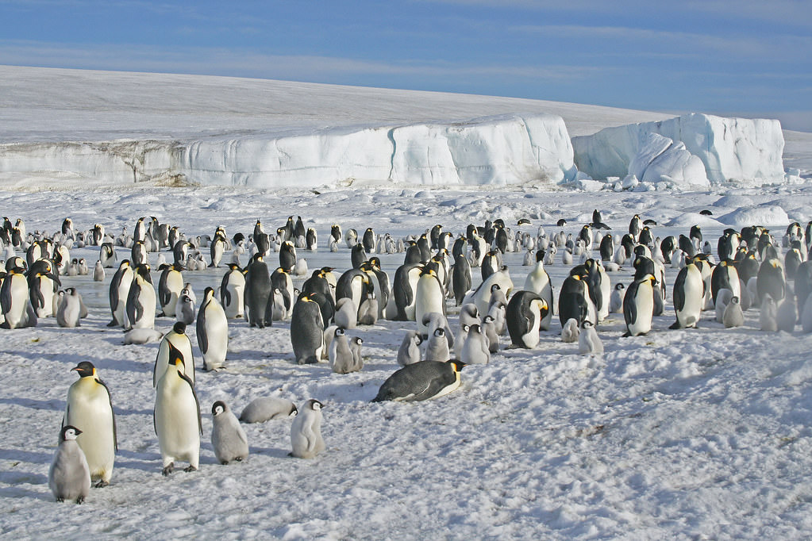
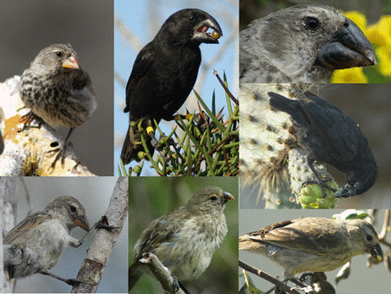
The popularization of Natural Selection
Darwin traveled the world observing (and taking samples) different species, but his main work was conducted in the Galápagos Islands on a variety of species, especially a population of Finches (birds).
A population is a particular group individuals belonging to the same species, like the Galápagos finches (as opposed to finches in Maple Ridge).
Another example would be a population of penguins in Antarctica, vs a population of penguins in Chile.

Slide 5
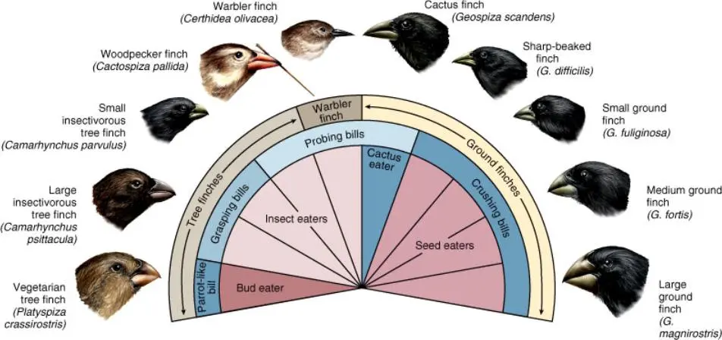
The work of CHarles Darwin
Darwin studied 18 species of finches. The birds had different beak types that related to what each finch ate each day.
Each of the bird’s beak is different.
It was different because it evolved for eating a particular food source.
The beak shape was fittest (best adapted) for the particular food that was around.

Slide 6
Natural Selection's Five Points
Charles Darwin's theory of natural selection contains 5 points:
Population has variations.
Some variations are favorable.
More offspring are produced than survive.
Those that survive have favorable traits.
A population will change over time.

Slide 7
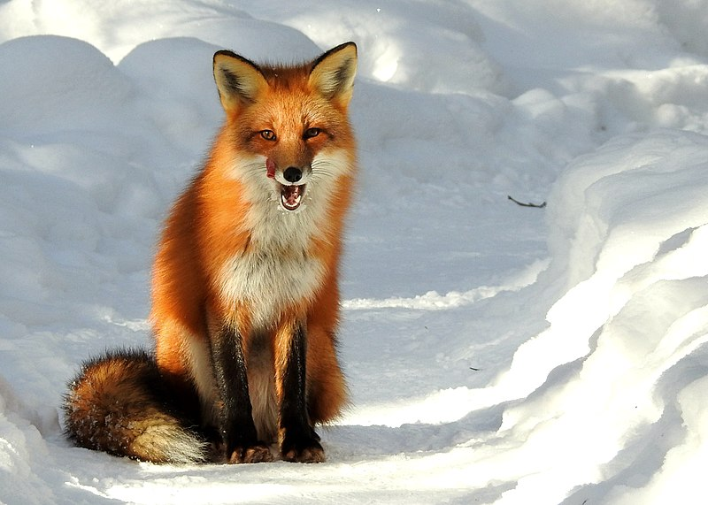
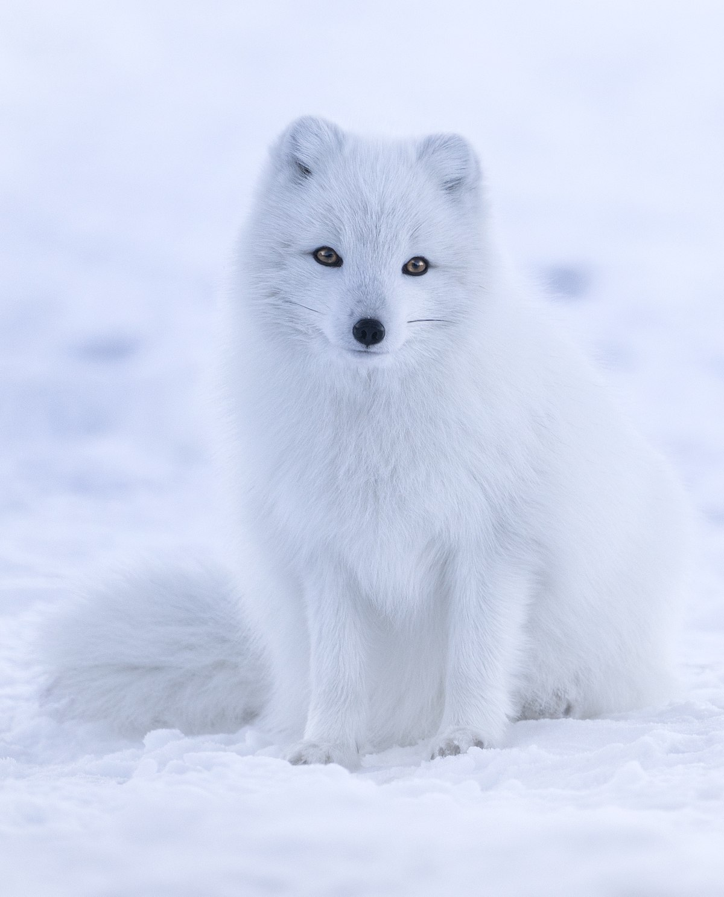
Natural Selection example
There is a fox with white fur and a fox with red fur in the artic. Each fox has 10 offspring. 8 of the white foxes survive, while only 3 of the red foxes survive.
There are 2 variations here, red and white fur.
2. White fur is better for survival in the artic. (Blends in)
3. More offspring are produced than survive.
4. Those that survive have favorable traits. In this case, white fur.
5. A population will change over time. In this case, over time the population will have more white furred foxes.

Slide 8
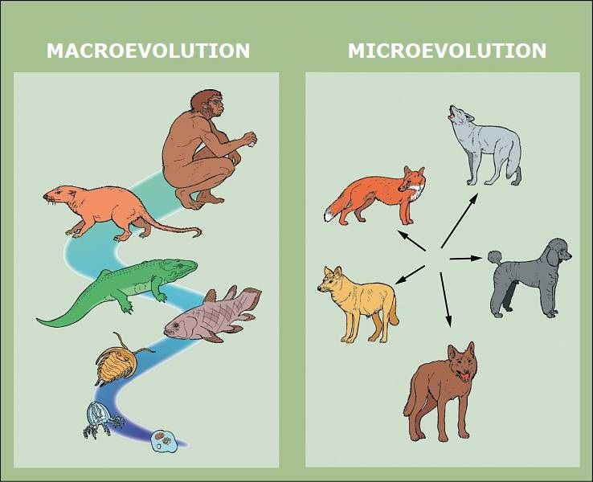
The Theory of Evolution
The idea of natural selection led to evidence that supports the theory of evolution.
Evolution is the change in heritable characteristics of biological populations over successive generations. (In other words, as natural selection favours/picks particular traits, species change, adapt to their surroundings.
Evolution details that all life came from pre-existing life and simply evolved over time. Example: Humans came from Chimpanzees and share 99% of the same DNA code.

Slide 9
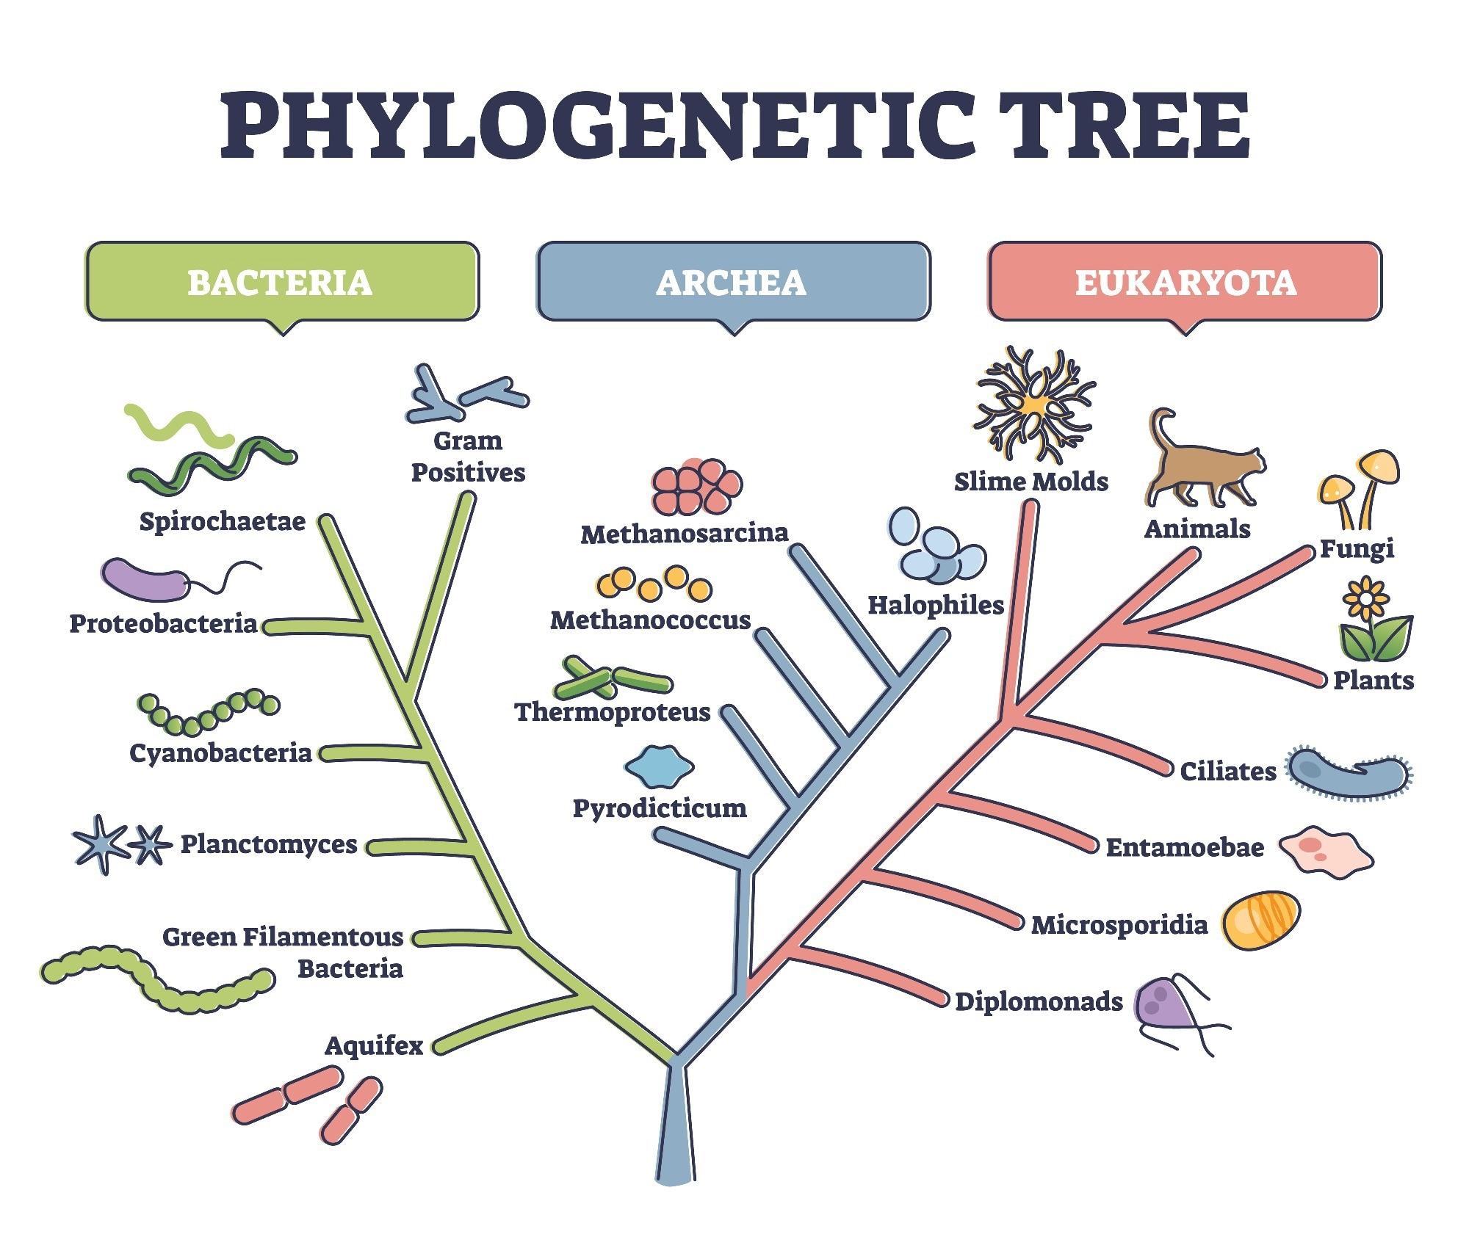
Proof for Evolution
We have found organisms with very similar DNA, and can create family trees for species (called Phylogenetic trees).
Other evidence includes Homologous Structures, which are limbs and other parts of a species that resemble similar structures in other species.
Not to confused with Analogous Structures, which are different structures no common ancestor but they each serve similar functions. (Like a birds wing and a bats wing – Different structure but same functions – Flight)

Slide 10
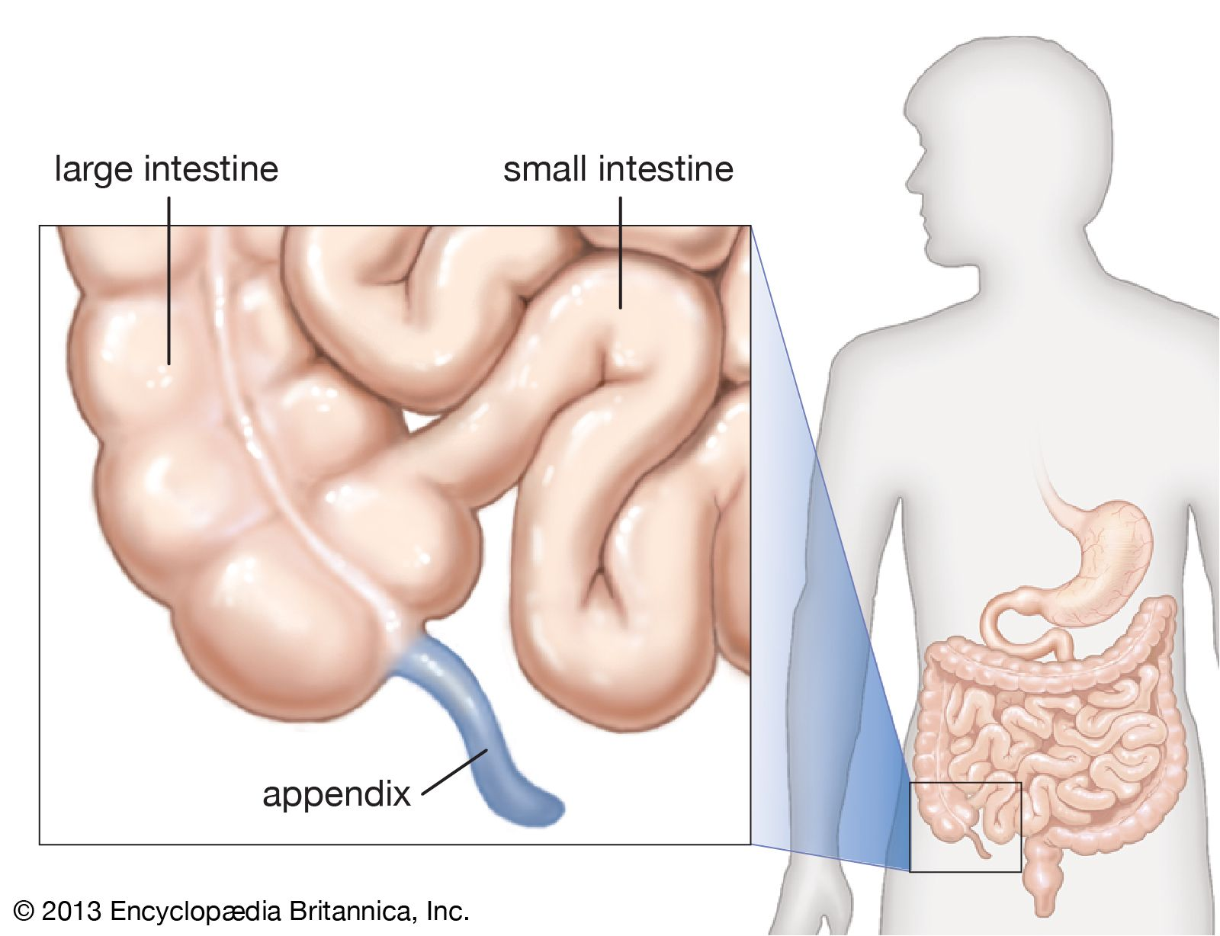
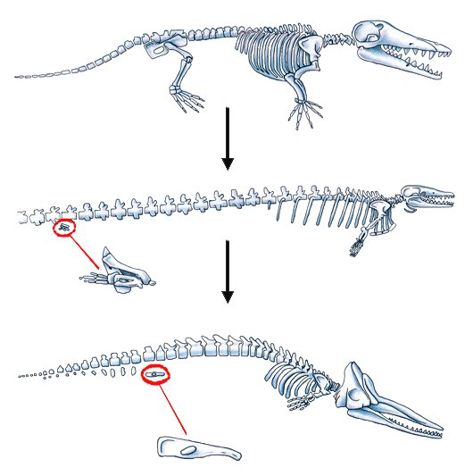
Proof for Evolution
The fossil record also supports the DNA predictions we have made, as new fossils "fill in" more entries or steps (“The missing link)”in the phylogenetic trees.
There are also vestigial structures, which are limbs or other parts of a species that serve no purpose in the organism. Examples include "legs”(leg bones) in whales, or a human appendix.
We have concluded vestigial structures are structures that the organisms evolved away from using, but have not yet been "selected" by nature to get rid of them, since they do not affect survival.

Slide 11
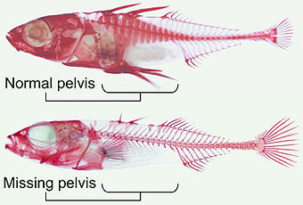
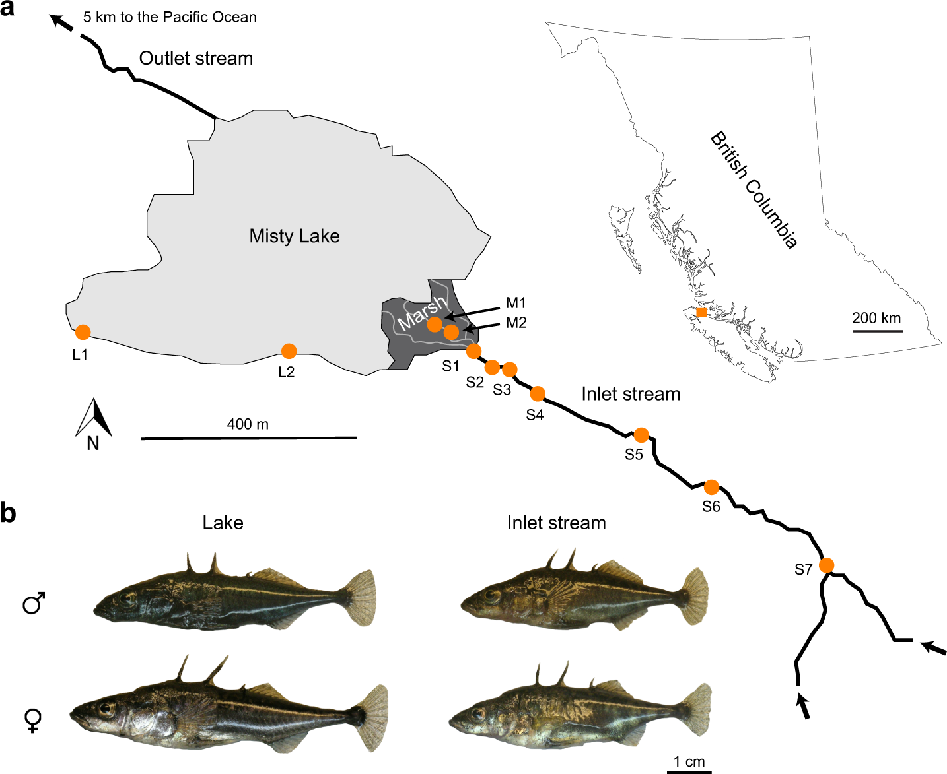
Proof for Evolution
There are many more pieces of evidence too, such as geographical separation evidence
Populations separated by geography adapt to different conditions, and therefore end up evolving into different species.
The diagram shows the stickleback fish, a fish with different subspecies all over the world. Many British Columbia lakes and geographical events, like mudslides, separated them and resulted in Stickleback which adapted in different ways.

Slide 12
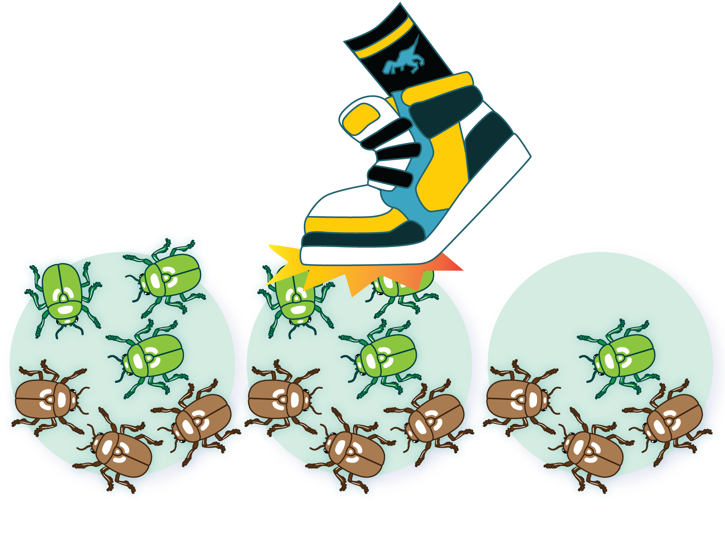
Other factors that impact Evolution
Genetic Drift – When a random event causes changes to a population that does not reflect the strength of a trait.
Example: Being a brown bug had nothing to do with the student stepping on the green bugs. It was a random event.
Genetic Shift – A sudden change to a genetically determined trait, typically caused by a random mutation.
Example: Viruses are the kings/queens of evolution. They mutate and exchange DNA randomly all the time to better attack their hosts and avoid the immune system.

Slide 13
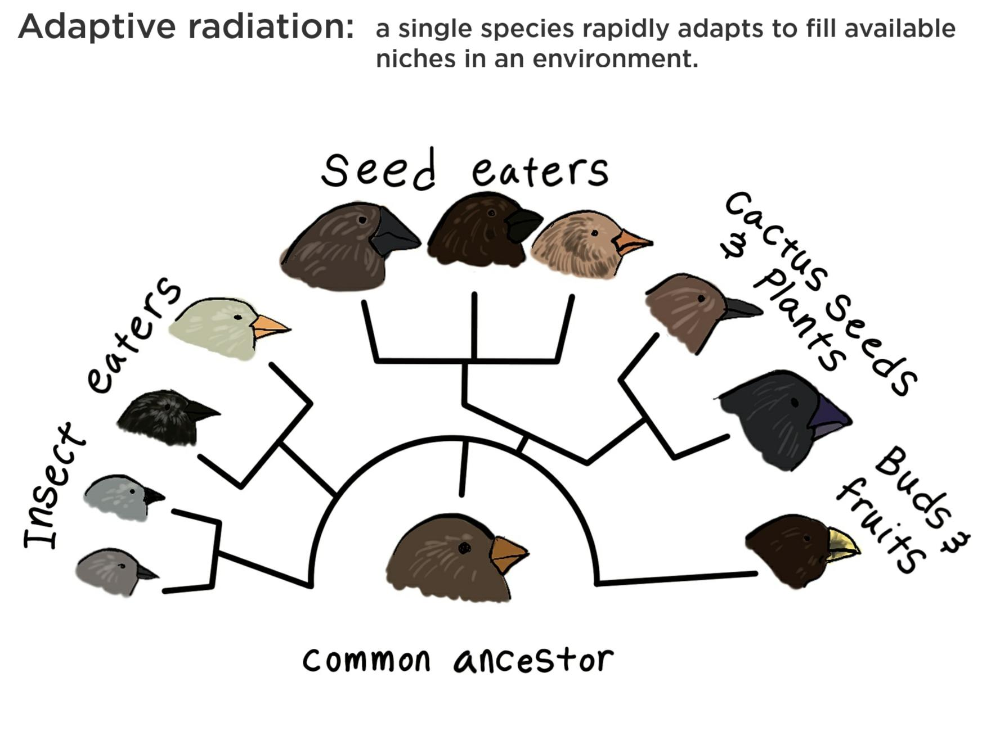
Adaptive Radiation
Sometimes many new species can evolve from the same common ancestor species to fill distinct niches (roles in the ecosystem). This is called Adaptive Radiation.
The finches are a perfect example of this, as many subspecies co-exist by eating different things (different eating niches)….One species “radiates” out into many subspecies.

Slide 14
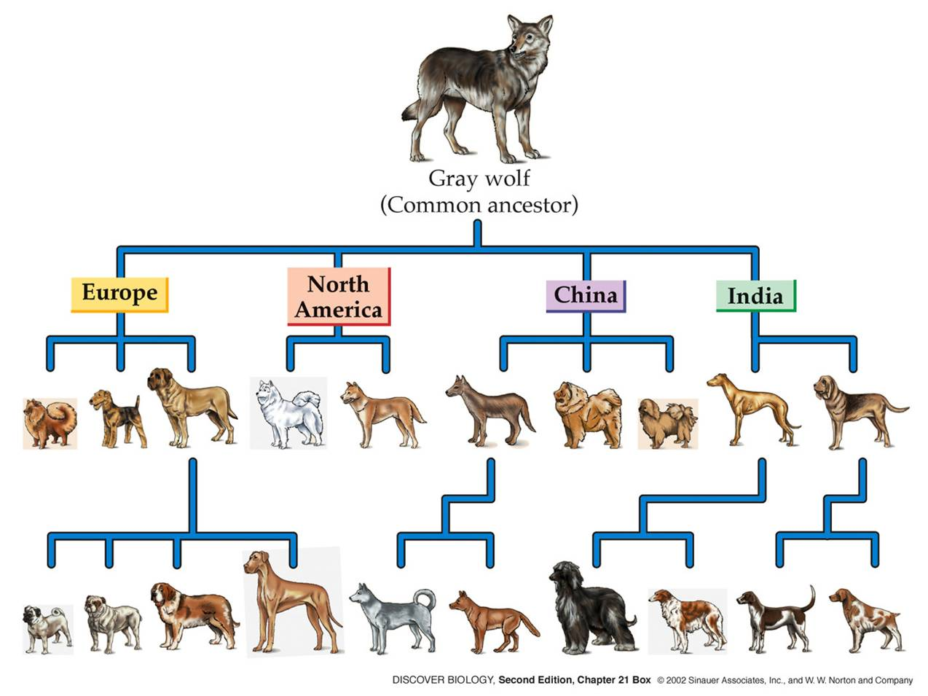
Artificial Selection
The word Artificial refers to things that are human made or caused. Artificial Selection is when natural selection is performed by humans, not nature.
Examples of Artificial Selection are dog breeding, gardening for specific traits, and farm animal breeding.
Many times, the traits selected in artificial selection are not to the benefit of survival…..Many dogs have negative conditions because "they are sooooo cute!”….(but would not survive without us).

Slide 15
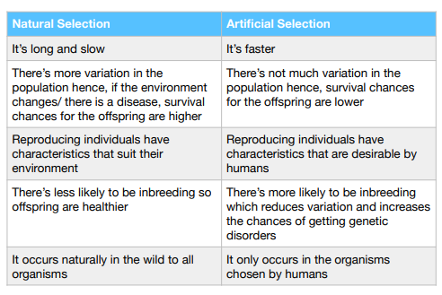
Positives and Negatives – Natural and Artificial selection

