Slide 1
Mendelian and Non-Mendelian Genetics

Slide 2
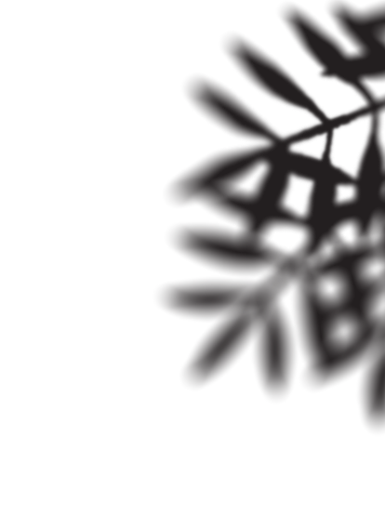
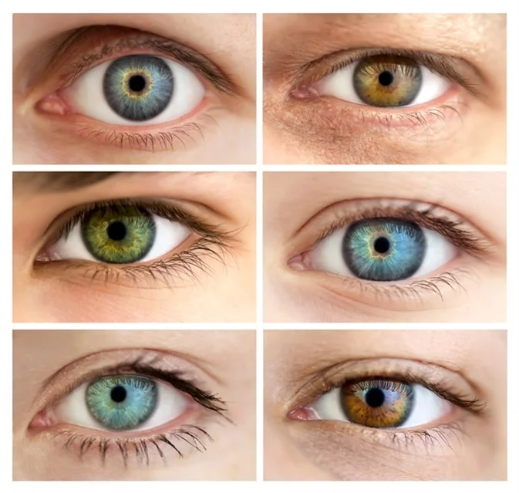
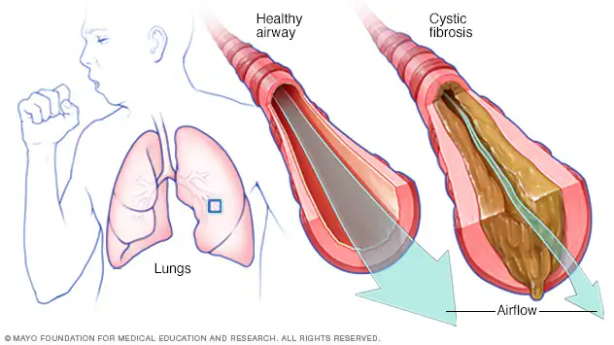
Traits
From the last learning guide, we found that our DNA has genes that code for proteins.
Each protein has a function (use) for an organism.
The characteristics of a protein are called traits.
Traits can be beneficial, or damaging to the organism.
Traits can be qualitative like blue eyes, or Traits can be quantitative like height or blood pressure.
Traits do not need to have a visual indicator.
Chandra Bahadur Dangi, at 21½ inches with the world's tallest man, Sultan Kosen, who stands 8 feet 3 inches tall.

Slide 3
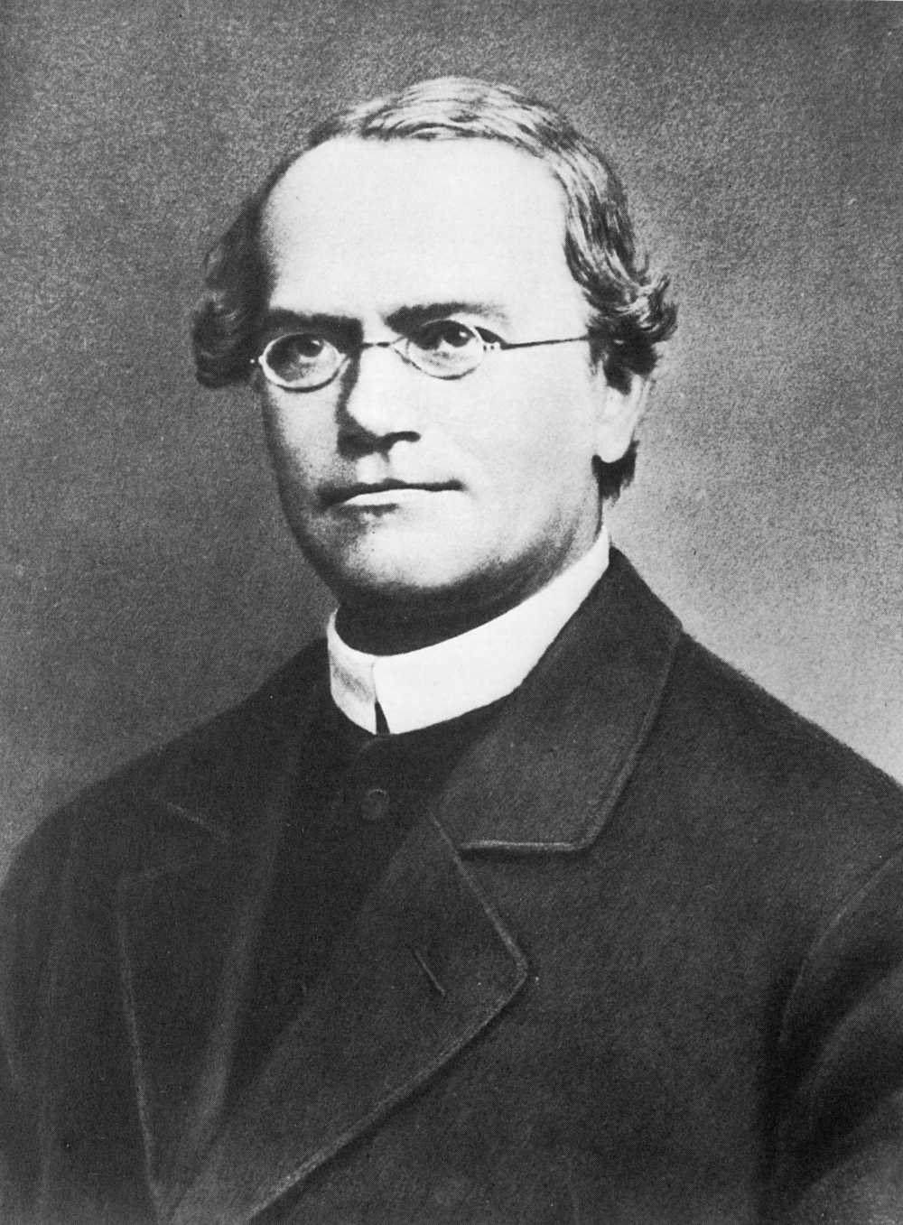
Genetics and Gregor Mendel
Genetics is the study of genes and heredity (how genes are passed down to offspring/children).
The person with the title of ”The Father" of genetics is Gregor Mendel, a German-Czech biologist, meteorologist, mathematician, an Augustinian friar and abbot of St. Thomas' Abbey in Brno.
Gregor Mendel lived and studie before most modern understanding of cell biology, and only the idea of crossbreeding farm animals was common knowledge
While at the abbey, Gregor experimented with pea plants and found their traits were passed on by "invisible factors" (now called genes).
1822-1884, passed away of chronic nephritis (Kidney Disease)

Slide 4
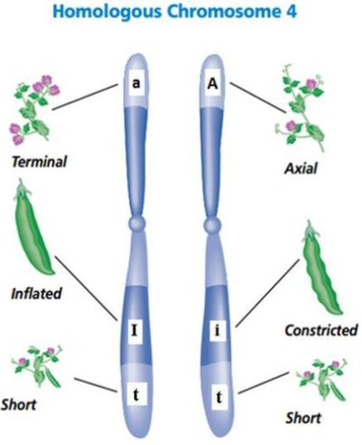
Pea Plants – Wrinkled or Round
Let's look at a gene that controls how wrinkly a pea will look. We will call the gene "R" (like Mendel did) (note: the picture is just an example without R)
Each Pea plant has two copies of each chromosome, one from the "father" plant and one from the "mother" plant.
Chromosomes that match each other in size and gene types are called homologous chromosomes.

Slide 5
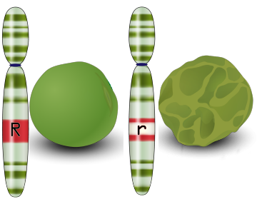
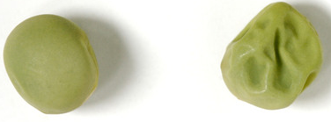
Pea Plants – Wrinkled or Round
Each chromosome pair can have its own version of the wrinkled gene.
Different versions of the same type of gene are called Alleles.
In many cases, one allele is "stronger" than the other allele. (Dominant over….always expressed).
In the case of peas, the stronger (Dominant) allele is round, noted by writing the gene with a capital R.
The weaker (Recessive) allele is wrinkled, noted by writing the gene with a lower case r.

Slide 6
Genetic Terminology
Ask yourself: What gene is dominant in human eye-colour?
Before starting, if it helps, know that words that start with "homo" means same and words that start with "hetero" mean different.
If the pea plant has two dominant alleles (versions of the wrinkled gene), the plant is called homozygous dominant, (RR).
If the pea plant has one dominant and one recessive, the plant is called heterozygous and the dominant gene is "wins", (Rr).
If the pea plant has two recessive alleles, the plant is called homozygous recessive, (rr).

Slide 7
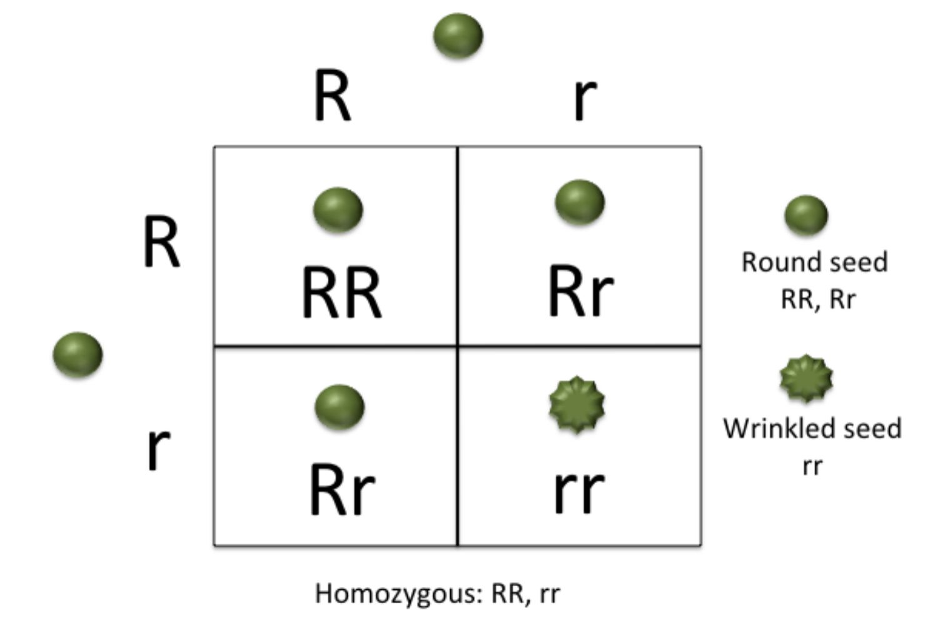
Punnett Square – A Prediction Model
Through experimentation (using gardening skills and math), Mendel crossed two pea plants that were heterozygous and found there were roughly 75% round peas and 25% round peas.
A method for showing this is a Punnett Square. Draw a square and split it into 4 squares. Place one parent's alleles on top above each box and the other parents on the side next to each box.

Slide 8
Punnett Square – A Prediction Model
Fill in the boxes inside with the corresponding letters. The results inside the 4 squares are the possible results of the offspring/children pea plants.
In this case, we see there is a ratio of 1RR:2Rr:1rr. This is called the genotype ratio. Genotypes refer to the allele combinations we cannot see (the code or sequence).
We also see a ratio of 3 round peas to 1 wrinkled pea. This is called the Phenotype Ratio. Phenotypes refer to observable traits, like height, pea type, and blood type.
Note: can also be written as:
Percents - 25%RR:50%Rr:25%rr
Or fractions – 1/4RR:1/2Rr:1/4rr

Slide 9
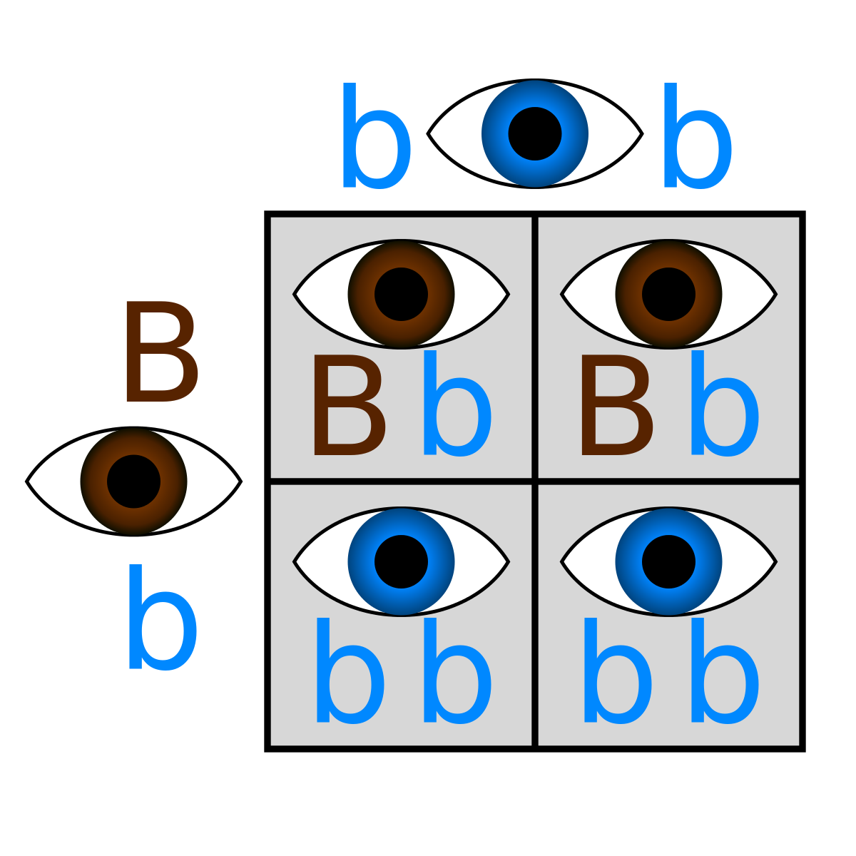
Punnett Practice
Try to fill in the following and state the genotype and phenotype ratios.

Slide 10
Punnett Practice
Genotype:
Ratio: 2Bb:2bb OR 1Bb : 1Bb (lowest terms).
Percent: 50% Bb:50%bb
Fraction: ½ Bb: ½ bb
Phenotype:
Ratio: 1 Brown:1 Blue
Percent: 50% Brown:50% Blue
Fraction: ½ Brown: ½ Blue
Note: These ratios are chances, not exact numbers. (Just like a coin flip may not be exactly as it happens)

Slide 11
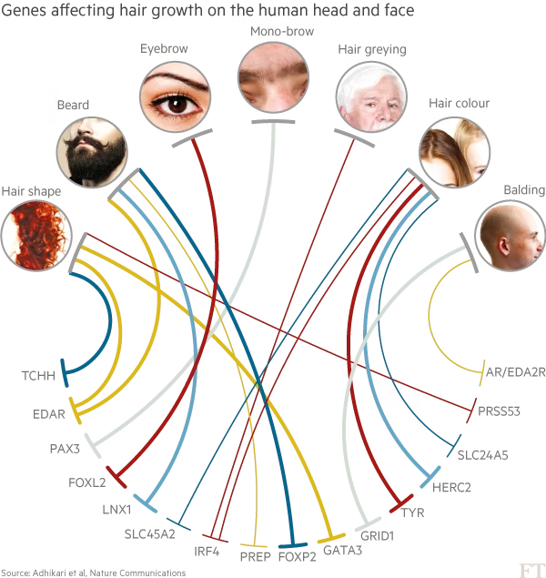
Non-Mendelian Genetics
Gregor Mendel was extremely lucky. The pea plant traits he chose were simple to understand, while many other types of genes are complicated.
Genes that do not follow the Punnett Square predictable inheritance seen in Mendel's work follow Non-Mendelian Genetics.
These genes may interact differently or have different ratios of inheritance.

Slide 12
Incomplete Dominance
Incomplete Dominance is when neither allele is Dominant and masks the phenotype of the other allele and an "in-between" phenotype is created.
The in-between phenotype occurs in heterozygous organisms.
An example of this is a red flower crossed with a white flower gives a pink flower
Note: in the picture, the "P-Generation" is the parent generation, and the "F1-Generation" is the generation number after the parent (F is short for Filial).

Slide 13
Codominance
Codominance is when neither allele of a gene masks the phenotype of the other allele, and both exist at the same time.
The two phenotypes only co-exist in heterozygous organisms.
An example of this is a red flower crossed with a white flower gives a flower with both red and white petals.
The petals can all be one colour, or can be spotted/striped, or have other patterns with both colours.

Slide 14
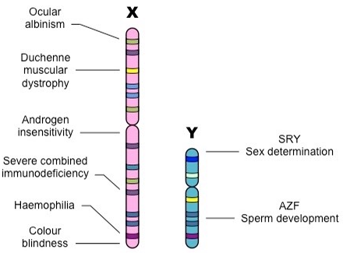
Sex-linked Genes
Recall that the X and Y chromosomes in humans are responsible for anatomical sex (Chromosome 23).
Males have an X and a Y chromosome
Females have two X chromosomes
The X-chromosome is longer and has more genes on it than the shorter Y-chromosome.
Certain conditions such as the recessive Colour blindness or the recessive Hemophilia conditions are caused by genes only found on the X-chromosome.
This means males get the conditions more, since they only have 1 X chromosome. (XY)

Slide 15
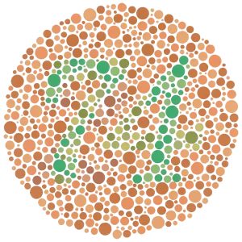
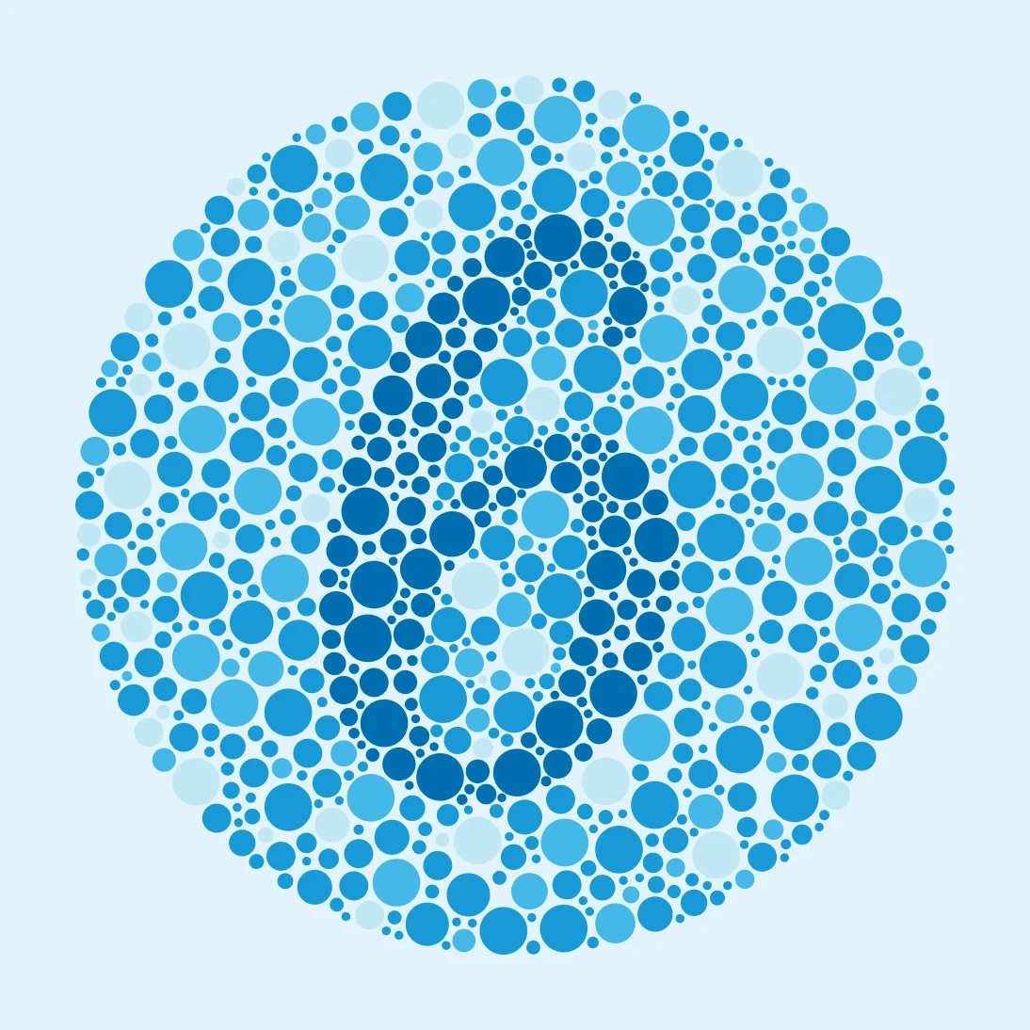
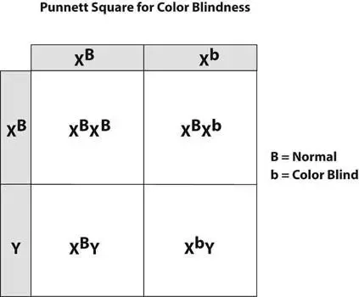
Sex-linked Genes
Sex-linked genes can still be shown using Punnett Squares.
The notation for Sex-linked chromosomes is:
_{X}^{n} , where the small letter above the X is the gene letter.
Y , which does not have anything else, since it is missing the gene.

Slide 16
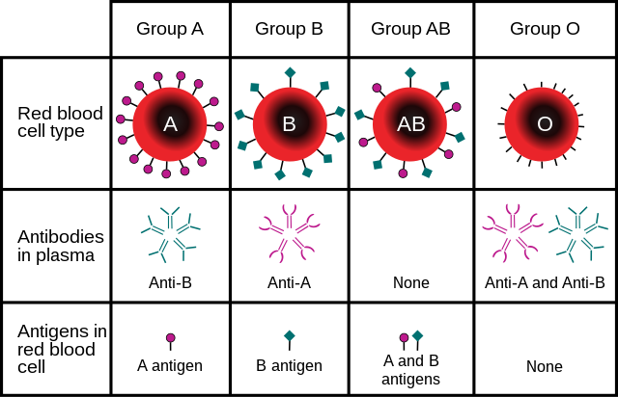
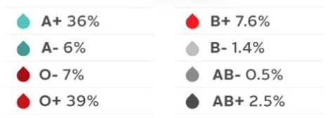
Multiple Alleles (Blood Types)
Some genes have more than two versions (alleles) of a gene.
An example is blood type. There are three blood type Alleles
A for A blood types
B for B blood types
Neither A or B, for O blood types
The gene is linked to immune system activation. It tells you what your body "allows" on the sides of your cell.
If incorrect blood is given to a patient, blood clots caused by the immune system form.
Blood Types in Canada

Slide 17
Multiple Alleles (Blood Types)
 |  | Mother
 |  | I^{B} | i
Father | I^{A} | I^{A}I^{B} ^{AB blood type} | iI^{A} ^{A blood type}
 | i | iI^{B} ^{B blood type} | ii ^{O Blood type}
Similar to the sex-linked gene notation, we write the letter of the gene, followed by the allele version as a superscript (above it).
In the example for blood type, we use:
I^{A} for the A allele
I^{B} for the B allele
i with nothing for either A or B (O allele)

Slide 18
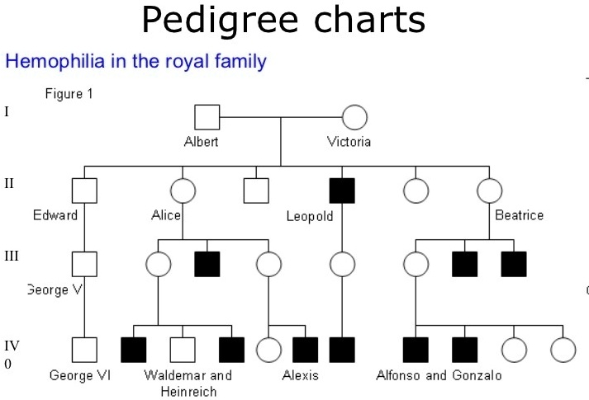
Pedigrees
Pedigrees are charts used to follow a particular trait through a family tree.
Pedigrees can give us hints about traits with little experimentation. Hints towards:
Recessive or dominant
Sex-linked
Non-Mendelian genetics
How harmful the trait is

Slide 19
Pedigrees
The pedigree on the right follows the trait for Hemophilia through the royal family.
The squares represent males, and the circles represent females.
White shapes represent healthy individuals, while black shapes represent Hemophilic individuals.
Note that only males have the trait, hinting at the trait being sex-linked.
Note that Hemophilia ends many branches of the tree, hinting that it is dangerous.

Slide 20
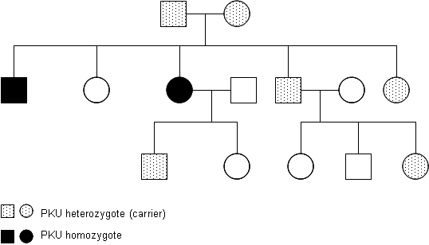
Pedigrees
A Carrier is someone who has the allele for a recessive condition but does not have the condition (in other words, they are heterozygous).
In this pedigree, carriers are marked with a dotted/shaded pattern OR shown as a half-filled circle (female) or square(male).
Note that recessive traits seem to "skip a generation".

