Slide 1
Chemistry 9 Review

Slide 2
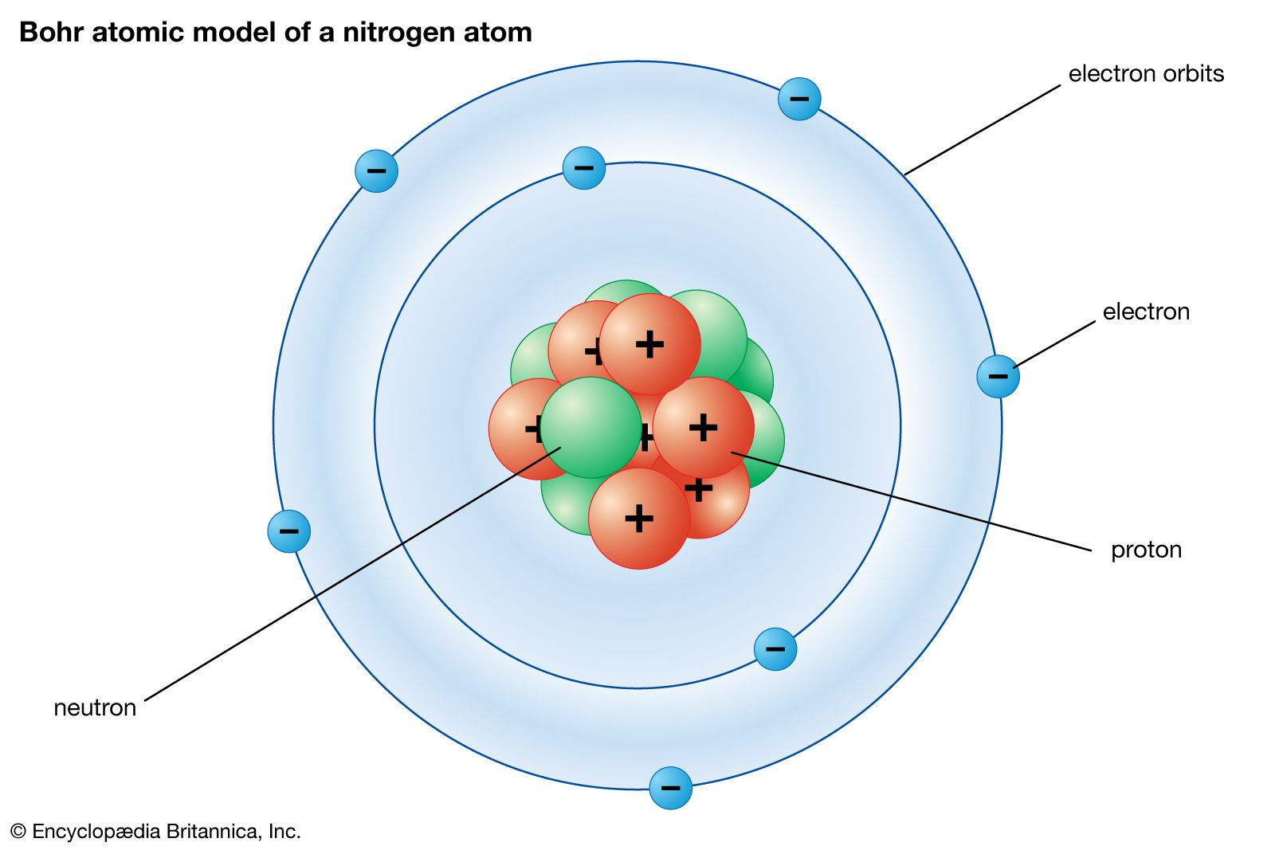
Atoms and Bohr Models
Our world is made up of tiny particles called atoms.
The atoms are made up of even smaller particles called subatomic particles.
Positive (+) Protons
Negative (-) Electrons
Neutral (0) Neutrons
The Electrons are located in the shells/orbits (circles). They are almost weightless.
The Neutrons and Protons are located in the nucleus (center). They contain the mass of an atom.

Slide 3
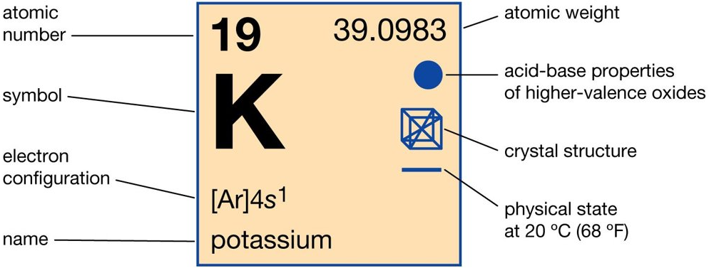
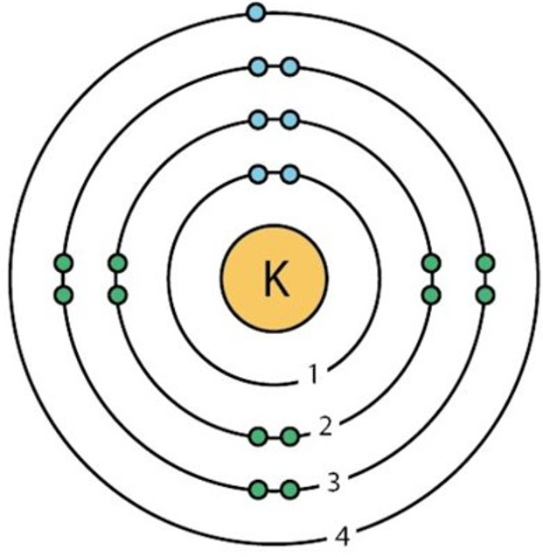
Atoms and Bohr Models
An element is a substance that cannot be broken down into any other substance.
The periodic table shows information about each type of element.
The Atomic number is the number of protons
The number of electrons in a neutral atom is equal to the number of atoms
The atomic weight is the mass of the element and is equal to the number of protons and neutrons. Subtract the protons and you are left with the number of neutrons.
In a Bohr model, the maximum number of electrons in each shell follows the pattern 2,8,8,18*.
* After element 20, the Bohr model does not work.
The protons and neutrons would be written in the center.
Always capitalize the first letter of the element
Electrons like to group in pairs (called lone pairs).

Slide 4
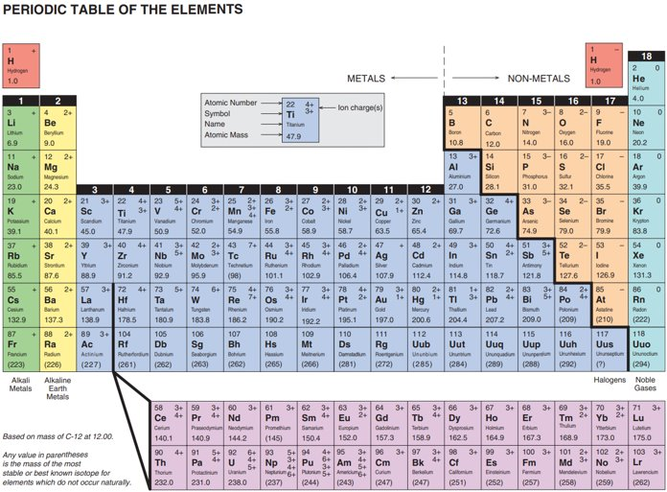
The periodic table of elements
Humans have made a table of all the known elements (found on Earth or human made)
There are 7 periods (rows) and 18 groups/families (columns)
Note the black "staircase" pattern on the right side of the periodic table.
All elements on the left of the line (except Hydrogen) are metals.
All elements on the right of the line are non-metals.

Slide 5
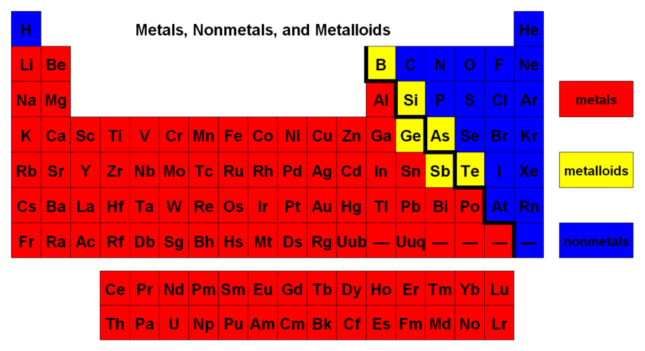
The periodic table of elements
Metals are:
Usually shiny
Ductile/Malleable - Can be easily deformed/shaped without breaking
Conductive of electricity
Usually high melting and boiling temperatures
Usually have a high density (feel heavy)
Non-metals are:
Usually dull looking
Brittle. Not ductile or malleable.
Usually do not conduct of electricity well
Usually low melting and boiling temperatures
Usually have a low density (feel light)
Metalloids/Semi Metals are the elements that are along on the black staircase on the right side of the periodic table
Metalloids have some properties of metals and some properties of non-metals

Slide 6
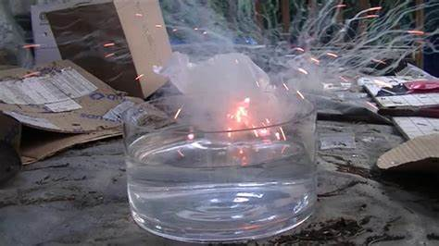
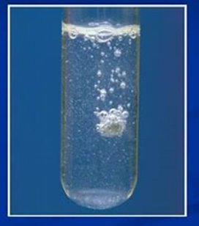
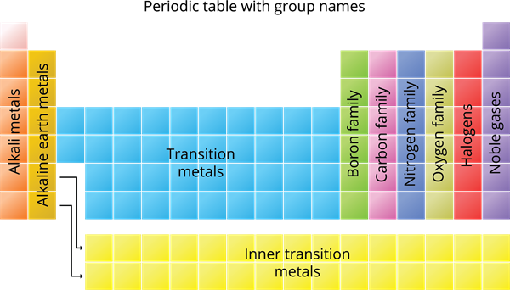
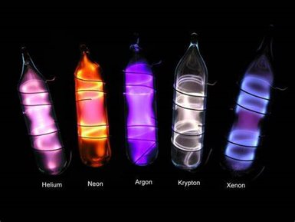
Important Families
<- Rubidium in water
Alkali metals are located in the first column of the periodic table. Alkali metals are extremely reactive metals.
The alkaline earth metals are located in the second column. They are strongly reactive.
The Halogens are found in second to last column. They are strongly reactive.
The noble gases are the in the last column and are completely unreactive.
<- Calcium in water
<- Bromine

Slide 7
Ions
Ions are versions of atoms that have a different number of protons than electrons.
This results in an overall charge on the ion (versus atom's neutral charge).
The atom will either lose or gain electrons to get to a full shell.
If it gains electrons, the result is a negative anion.
If it loses electrons, the result is a positive cation.
Ions are more stable than ions
They

Slide 8
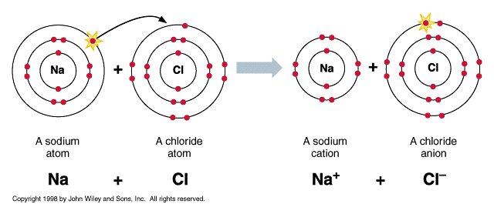
Ionic Compounds - Basics
The law of conservation of matter states that we cannot create or destroy matter.
In order for atoms to become ions, they must exchange electrons. After doing so, their opposing charges keep them together as compounds.
Compounds are always neutral
Ionic compounds always have a negative charge (typically a non-metal/polyatomic) and a positive charge (metal). They must cancel out.

Slide 9
Ionic Compounds - Naming
Ionic compounds always start with their metal, followed by their non-metal/polyatomic ion.
The ending of the non-metals always are changed to end in "ide". See the table.

Slide 10
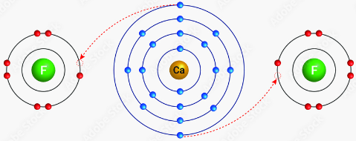
Ionic Compounds – Formulas
Formulas note down how many of each element/polyatomic ion you need in the formula to make the positive and negative charges equal.
Find the charges on the periodic table and use multiplication to make them equal if needed.
Example: Calcium = +2
Fluorine = -1
So, the formula is CaF₂ because we need 2 negative 1 charges (2 X –1 = -2) to be equal with 1 positive 2 charge (1 X +2 = +2).

Slide 11
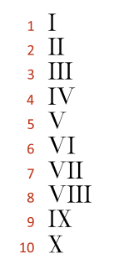
Ionic Compounds – Multivalent
Some elements on the periodic table have multiple charges. They are called Multivalent (for multiple charges). All multivalent elements in this course are metals.
Formula writing stays the same.
When creating names, we write the ionic charge we are using of the metal after the metal's name in roman numerals.
To find out which charge to use from a formula, use the non-metal/anion, as it will only ever have 1 possibility in this course.
Example: Chlorine has a charge of -1. So if the 1 titanium ion pairs with 4 chlorines, the Titanium must be +4 in charge. If there are 3 chlorines (-3), it must be +3 in charge.
TiCl₄
Titanium (IV) chloride
-------------------------------
TiCl₃
Titanium (III) chloride

Slide 12
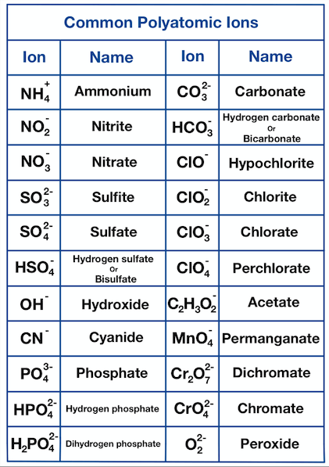
Ionic Compounds – Polyatomic Ions
If the compound name ends in "ite" or "ate", or if the compound has more than two elements, there is a polyatomic ion involved.
Polyatomic ions are when multiple elements are acting together to form one single ion with a charge.
Look to the back of the periodic table for the names and the charges of some of the polyatomic ions.
If multiple polyatomic ions are used, brackets go around the ion before stating the amount needed. No brackets are used of only one is used.
Note: You are only given 1 positive polyatomic ion.
Example: Ca(NO₃)₂
Calcium Nitrate
-------------------------------
Example: Iron (II) Phosphate
Fe₃(PO₄)₂
-------------------------------
Example: Ammonium Chloride
NH₄Cl

Slide 13
Covalent Compounds
Covalent (also called Molecular) Compounds are compounds made of 2 or more non-metals (with no metals).
Instead of giving or taking electrons, covalent compounds share electrons. The goal is still to get a full outer shell.
No formal charges are used since they do not gain a full charge from this interaction.
Covalent compounds are used for most biological life.

Slide 14
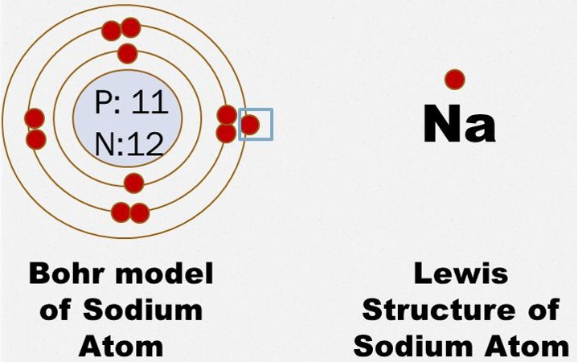
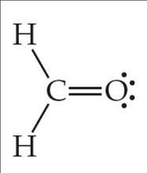
Lewis Models
In the previous slide, Lewis Models were used instead of Bohr Models.
Lewis Models are simplified Bohr Models commonly used for covalent compounds.
Lewis models only draw in the outer most electrons, as they are the electrons used for binding.
The outer most electrons are called Valence Electrons.
If we form a bond between two non-metals, a line represents a pair of shared electrons.

Slide 15
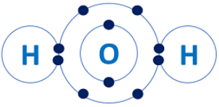
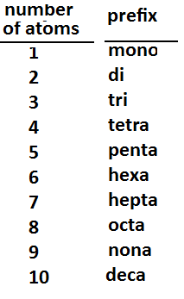
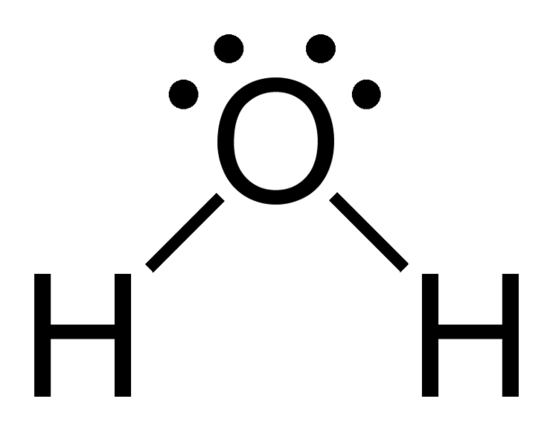
Naming and Creating formulas for Covalent Compounds
The formulas are still based on the number of each element needed to achieve full outer shells in each element.
To name these compounds, the number of each element needed corresponds to a prefix that goes in front of each element.
If the first element only needs 1, do not write mono.
If the second element is oxygen, some prefixes form conjunctions with the "o". Example: Carbon monoxide instead of Carbon Monooxide.
Common Name: Water
Covalent name:
Dihydrogen Monoxide
Formula: H₂O

Slide 16
Diatomic elements
Diatomic elements are elements that like to exist in pairs. To do this, an atom will create covalent bond(s) with another of atom of the same element.
These elements are H, N, O, F, Cl, Br, and I. You can remember where they are based on the "7" shape on the right of the periodic table, plus hydrogen on the left.
Additionally, pure phosphorus exists as P₄, and pure sulfur exists as S₈.

