Slide 1
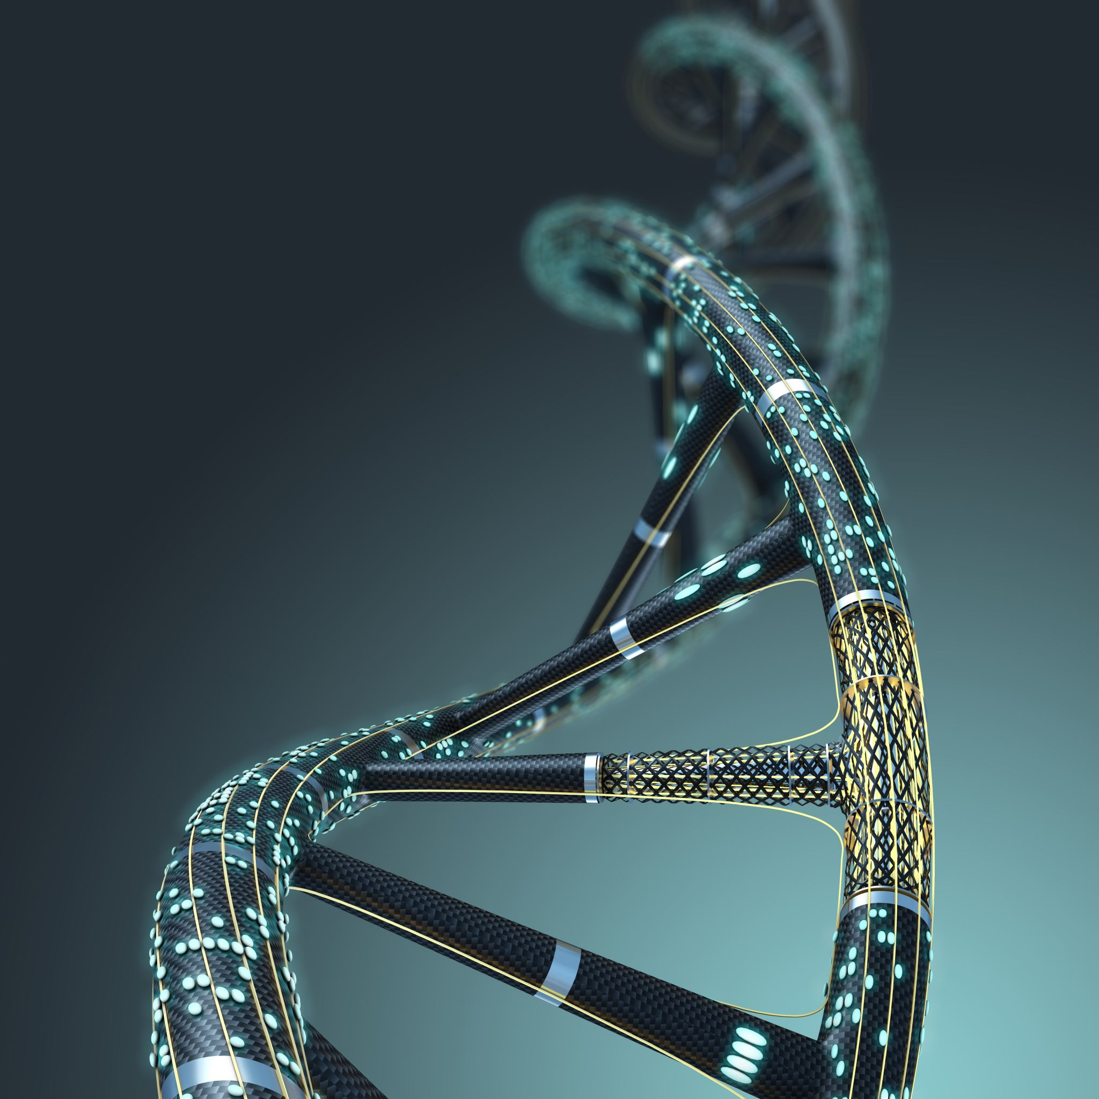
DNA to RNA to Proteins

Slide 2
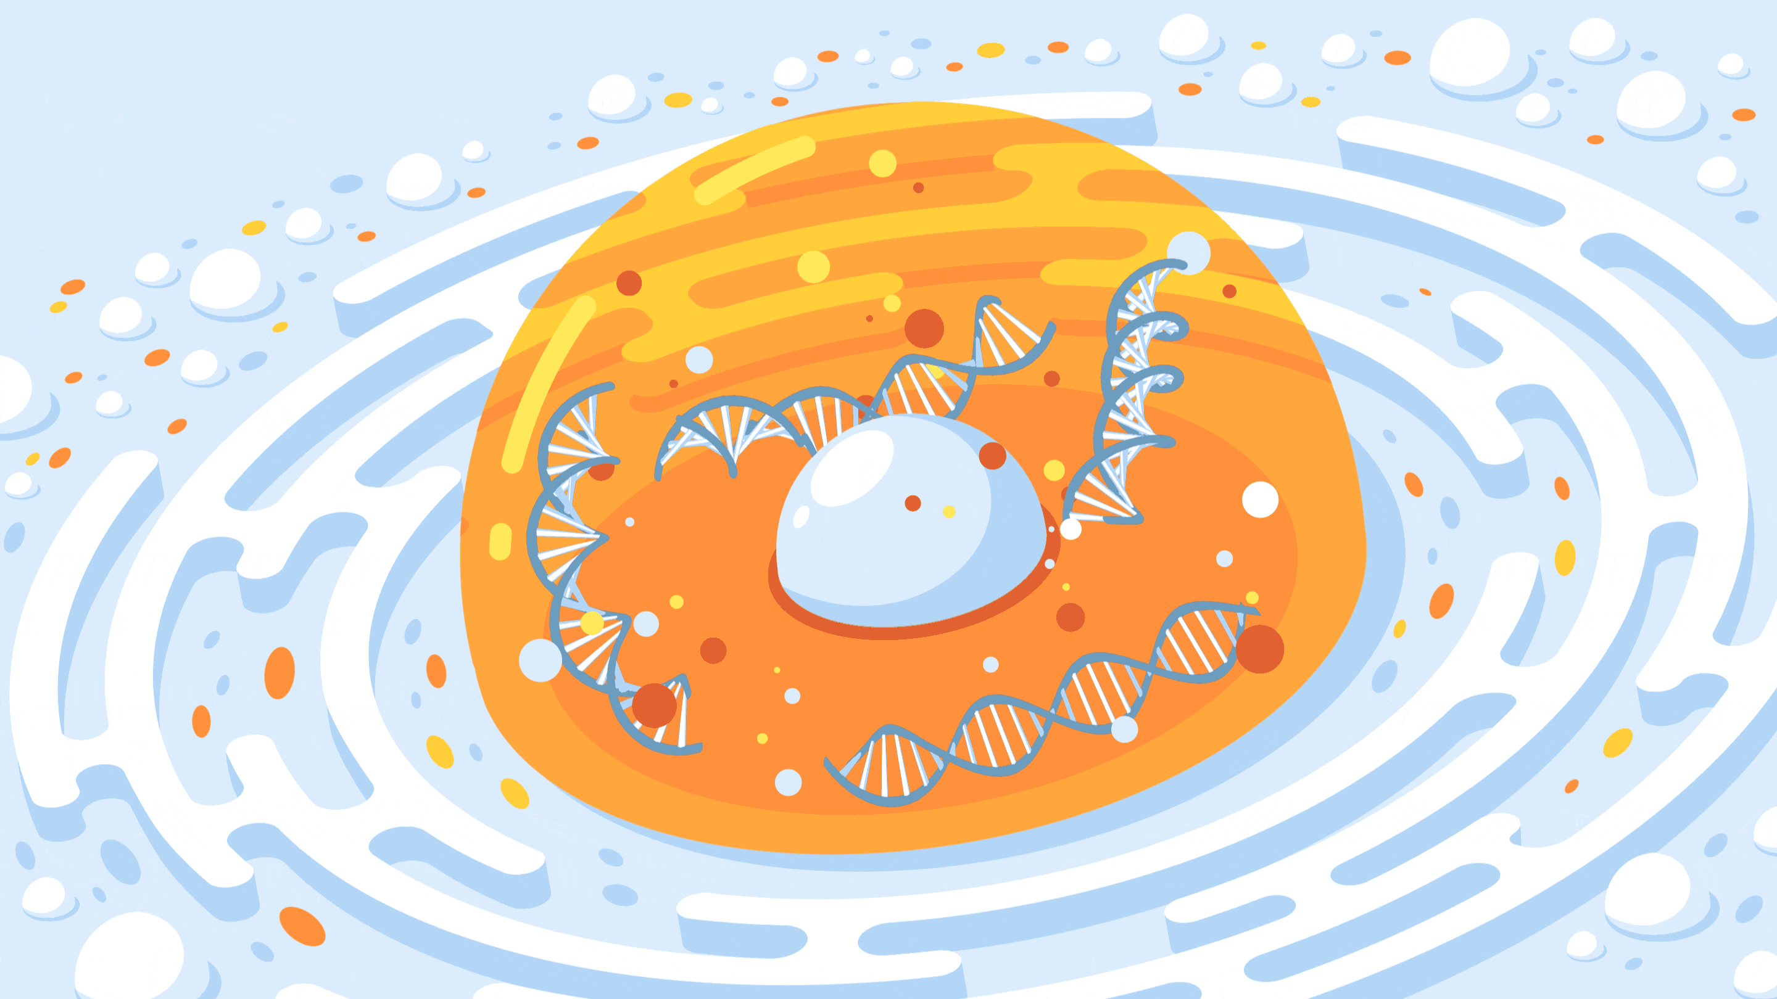
What is Deoxyribo Nucleic Acid?
DNA is found in the nucleus (control center organelle) of a cell.
It is an information molecule that codes for information on how to make proteins. (YOU)
Proteins are the molecular machines that do everything for the cell.
DNA has a twisted ladder (double helix) shape.

Slide 3
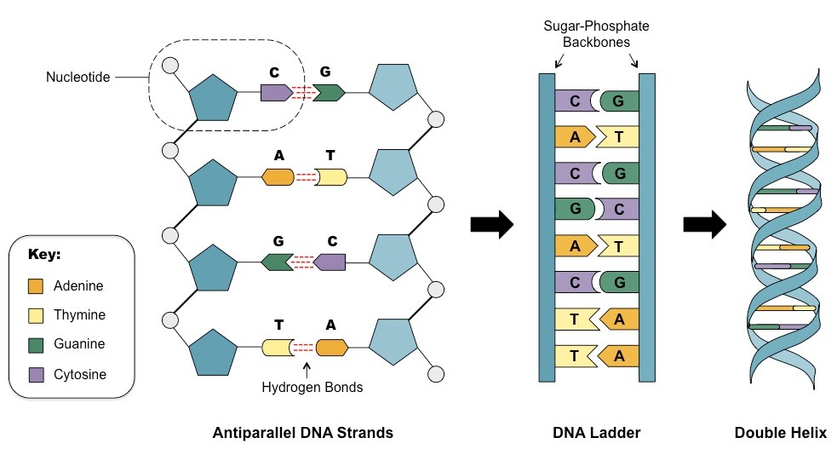
DNA Structure
DNA is made of repeating units called "nucleotides". Each nucleotide is made of:
A phosphate (the white circle) Backbone.
A sugar called deoxyribose (the blue pentagon).
1 of 4 nitrogenous bases
Adenine
Thymine
Guanine
Cytosine
The sugar and phosphates make of the backbone, while the bases glue the two strands together
C pairs with G, A pairs with T

Slide 4
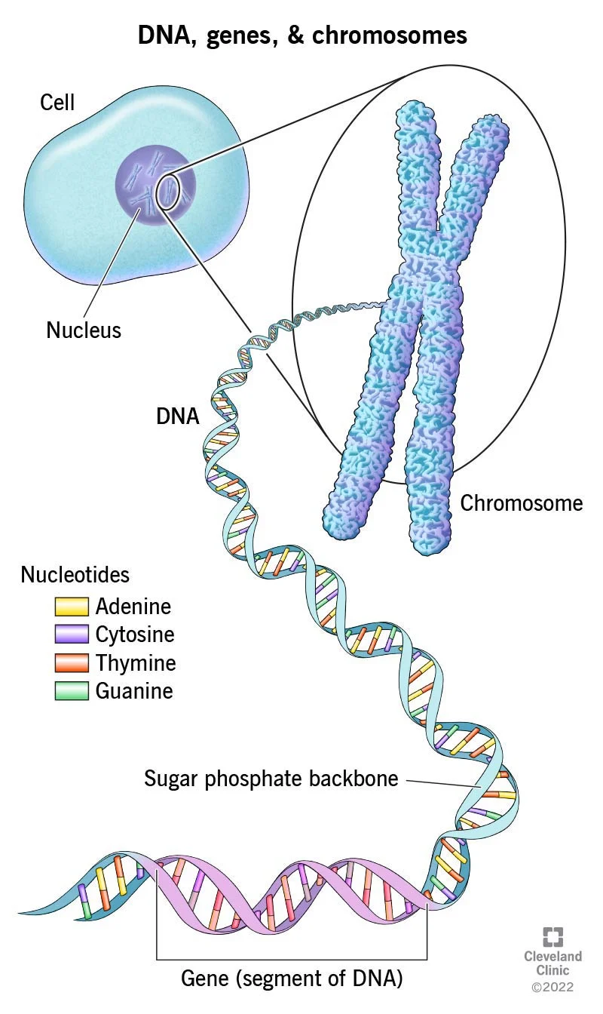
Chromosomes and Genes
All DNA has sections called genes. Genes are regions of DNA that code for certain proteins.
Complex organisms, like humans, wind our DNA into X shaped chromosomes. (Humans have 23 Pairs…)
Some simple organisms, like bacteria just have a circle of DNA.
Chromosomes are needed to effectively store complex DNA, since a human's DNA has about 3 billion base pairs (rungs of the ladder) in every cell!
Cool fact: stretched out, DNA would be 2 meters in length

Slide 5
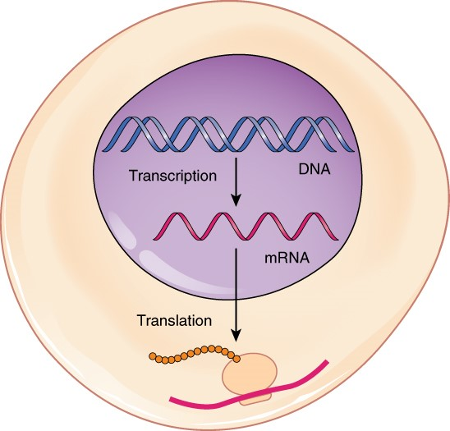
DNA = Blueprint, RNA = Photocopy
DNA MUST NEVER LEAVE THE NUCLEUS! It is the master blueprint of the cell.
Ribosomes are the structure that use this code to make proteins, but it is in the cytoplasm, usually by the Rough Endoplasmic Reticulum.
DNA must be copied into a molecule called Ribonucleic acid (RNA) that can go tell the ribosome how to make protein.
The process of making RNA is called Transcription.

Slide 6
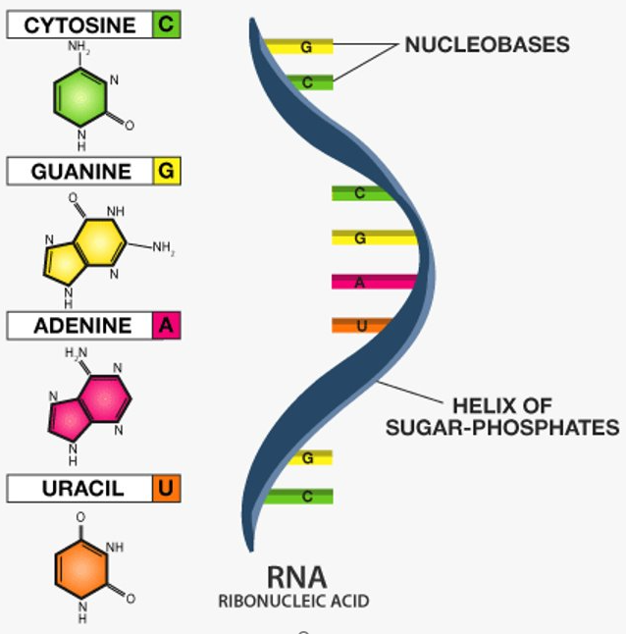
RNA Structure
RNA is way less stable than DNA.
RNA is single stranded.
RNA uses a nitrogenous based called Uracil in place of Thymine…..(So whenever there is a T, put a U).
RNA uses ribose instead of deoxyribose (which is why it is called ribonucleic acid instead) (Not as stable, does not last as long.

Slide 7
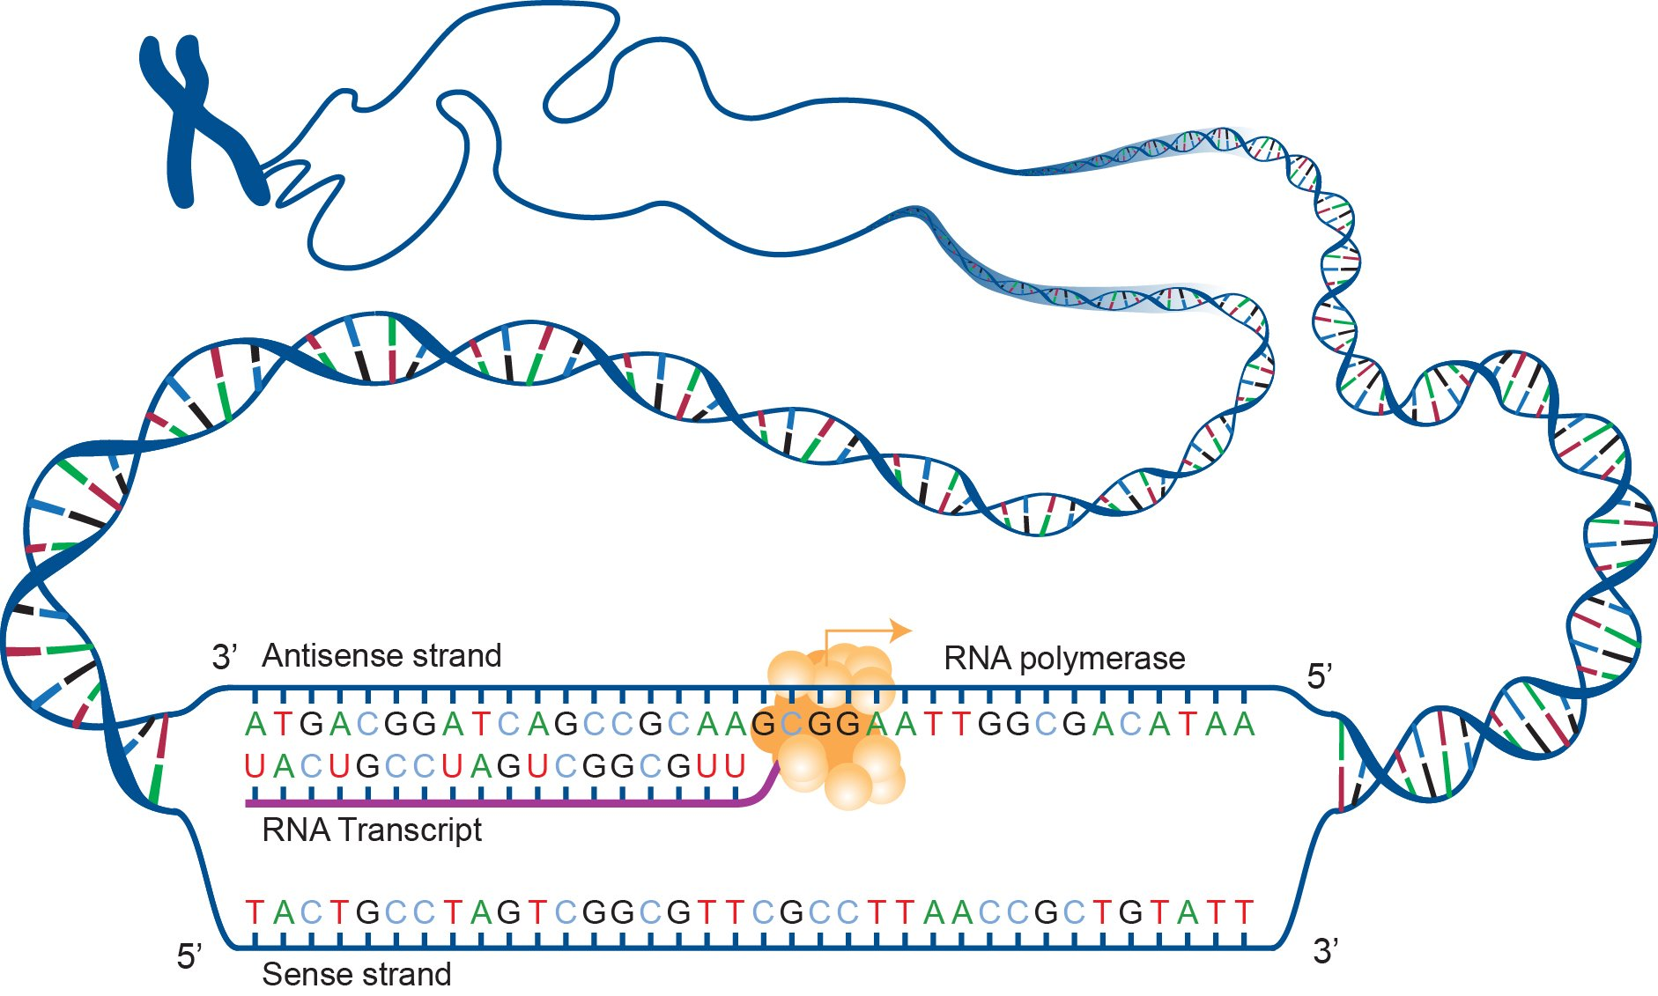
RNA Transcription
To make RNA, the DNA unwinds, and a copy of there (3) base pairs is made.
The DNA is then wound back up and the RNA leaves the nucleus (after some modifications).

Slide 8
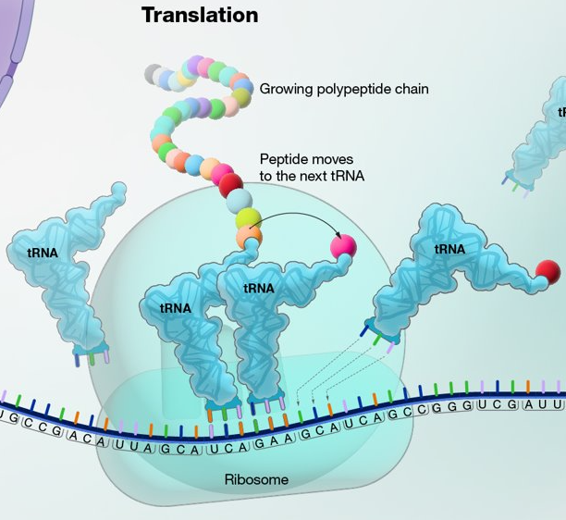
Translation
When the RNA leaves the nucleus and finds a ribosome, translation begins.
Translation is the process where the RNA code is read by the ribosome, and amino acids are chained together to create a protein (See the chain of circles).
https://youtu.be/qIwrhUrvX-k?t=151

Slide 9
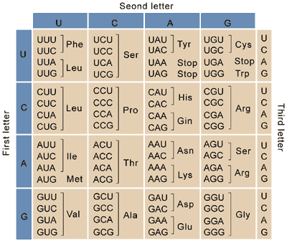
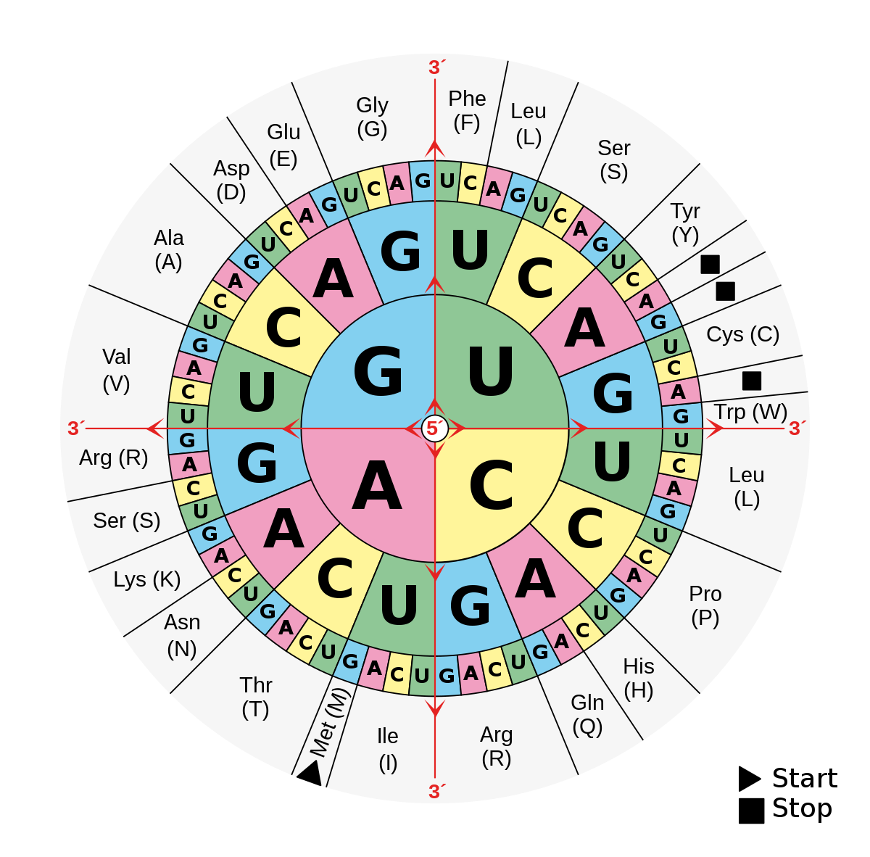
How does the Code work?
RNA is read three nitrogenous bases at a time.
Every three bases is called a codon.
The ribosome reads each codon and uses a decoder (which humans figured out) to see which amino acid to add next. Then it moves to the next codon and so forth.
Using our wheel or table, something like AAG would code for the amino acid Lysine (Lys).
AUG is always the starting codon (codes for Methionine) and there are three codons that tell the ribosome to stop.

Slide 10
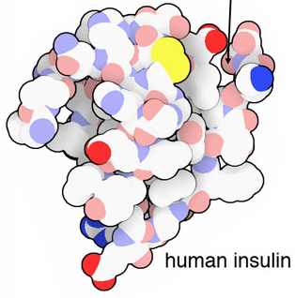
Protein Example
The protein will be made and then folded into the correct shape.
Here is a cartoon of an example of a protein: insulin.
Insulin was the first protein to be sequenced (first to have its code found).
Insulin is used by millions of humans everyday to help with a condition called diabetes.
Insulin controls the amount of sugar your cells allow inside.

Slide 11
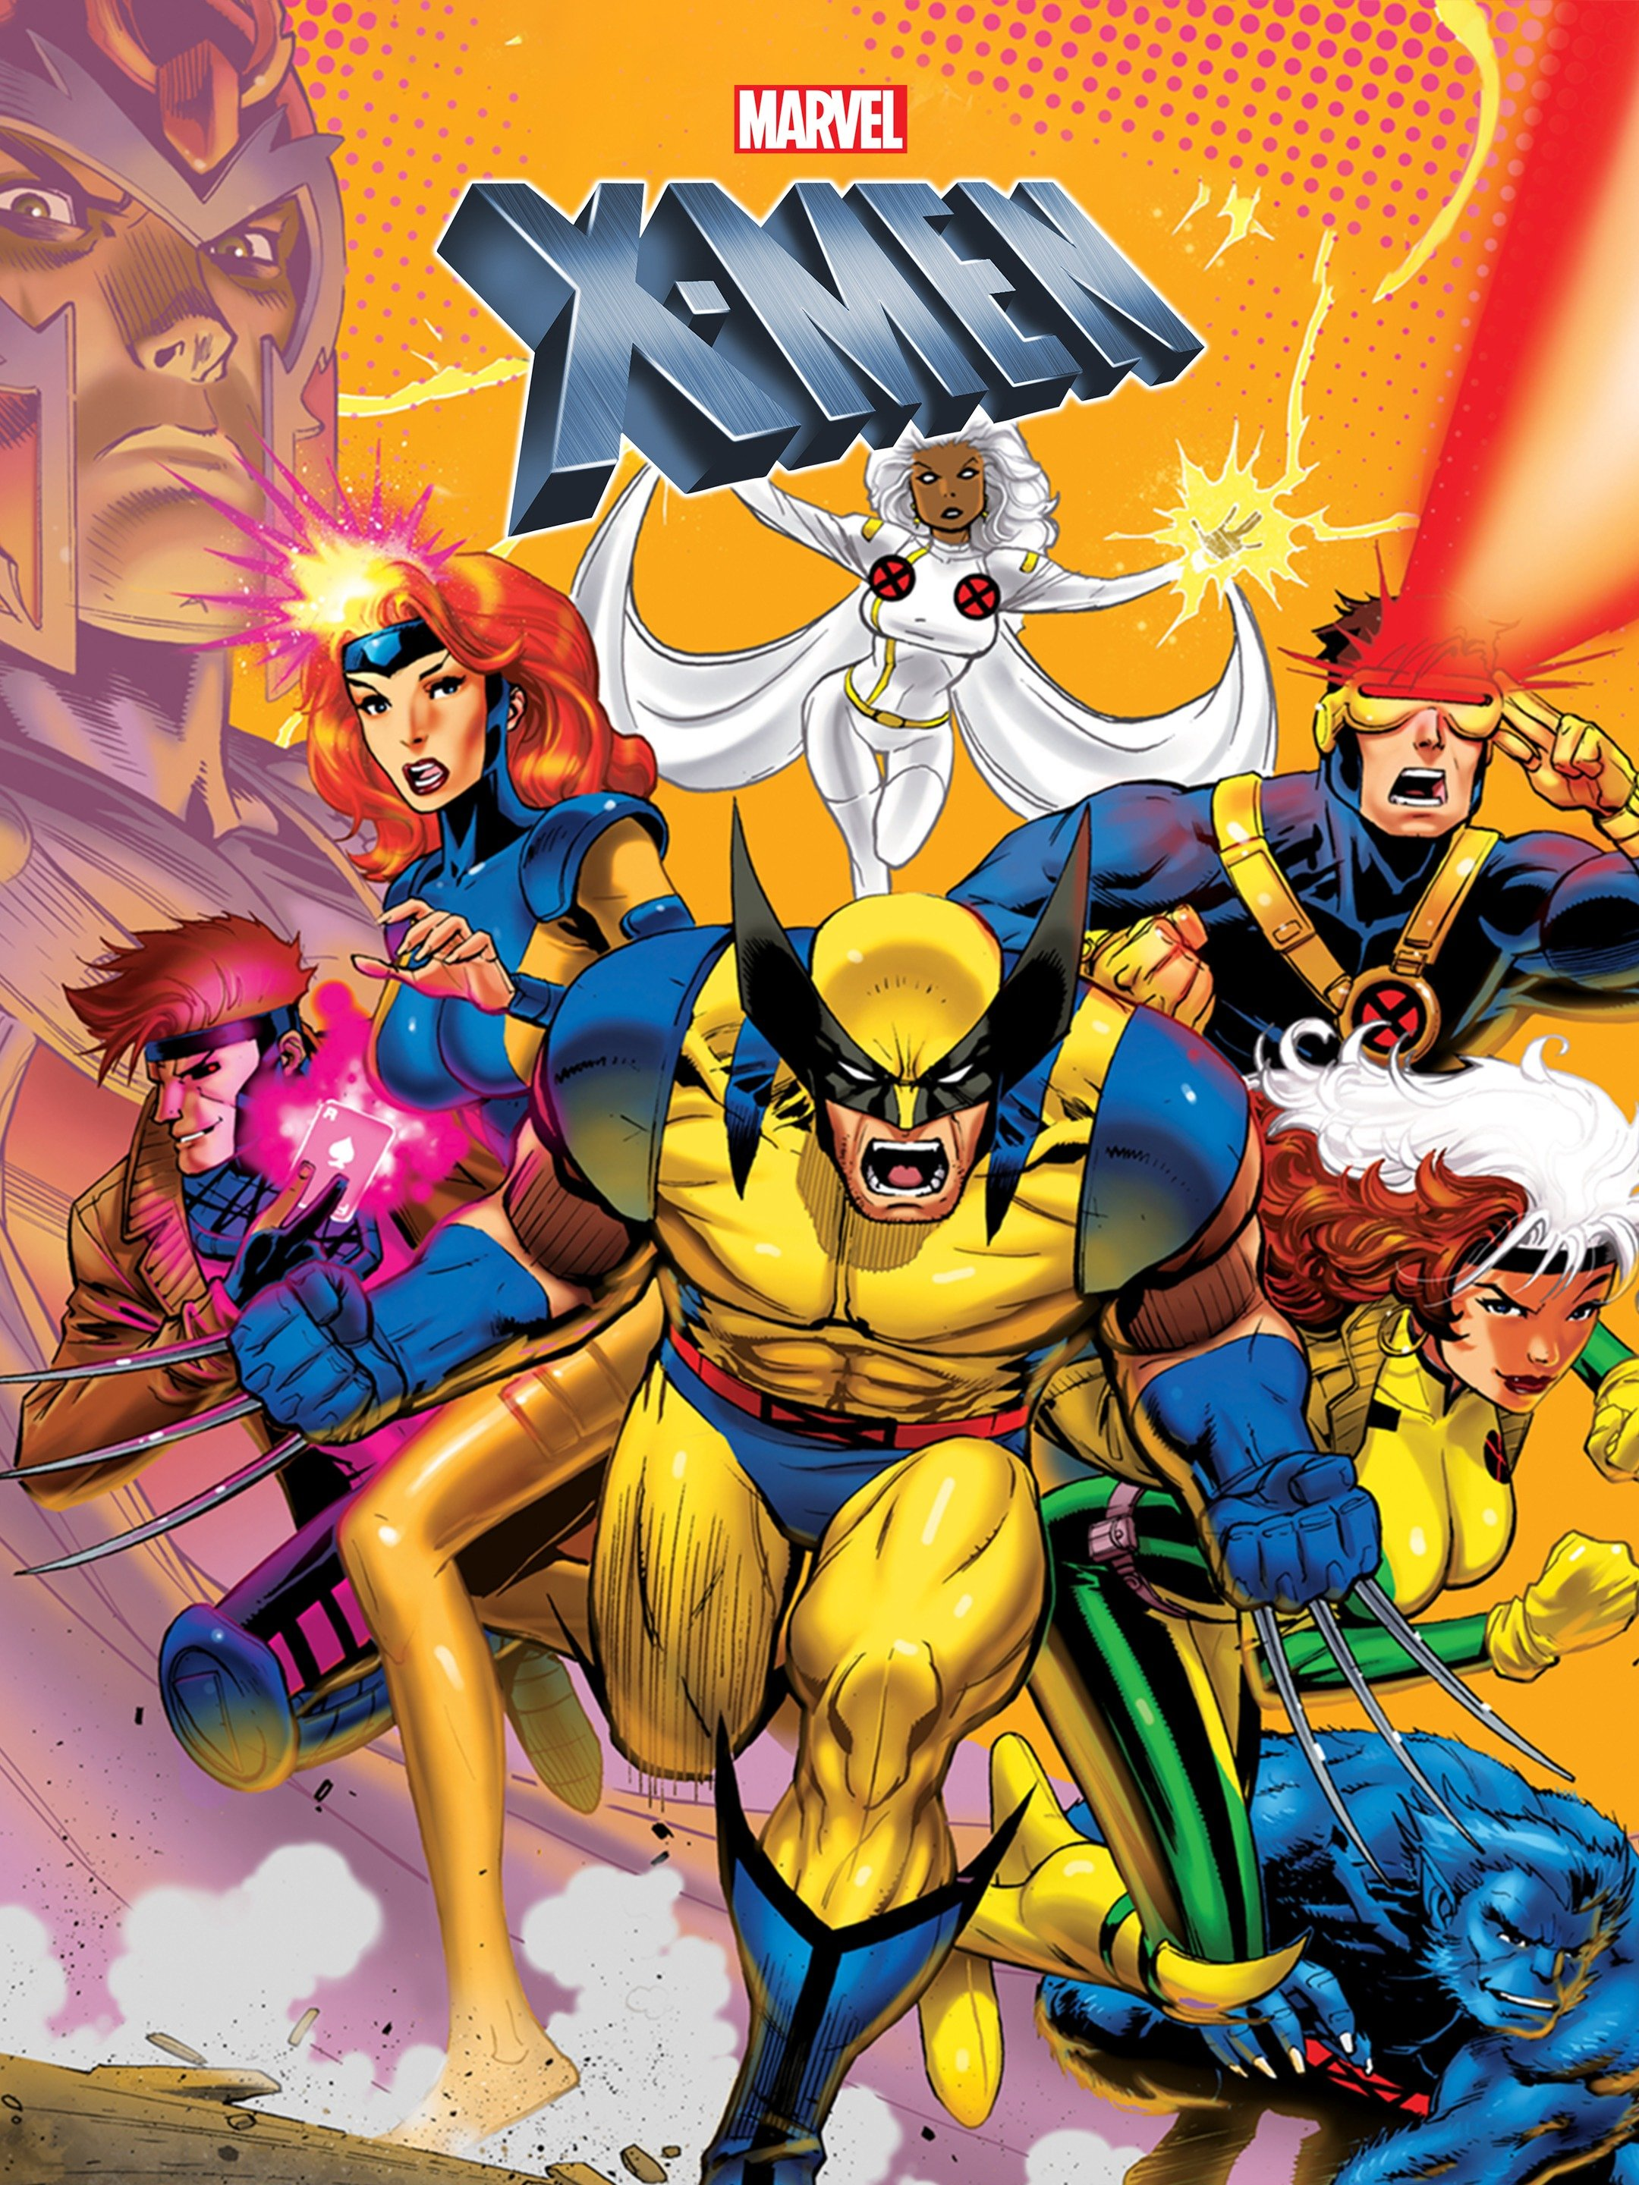
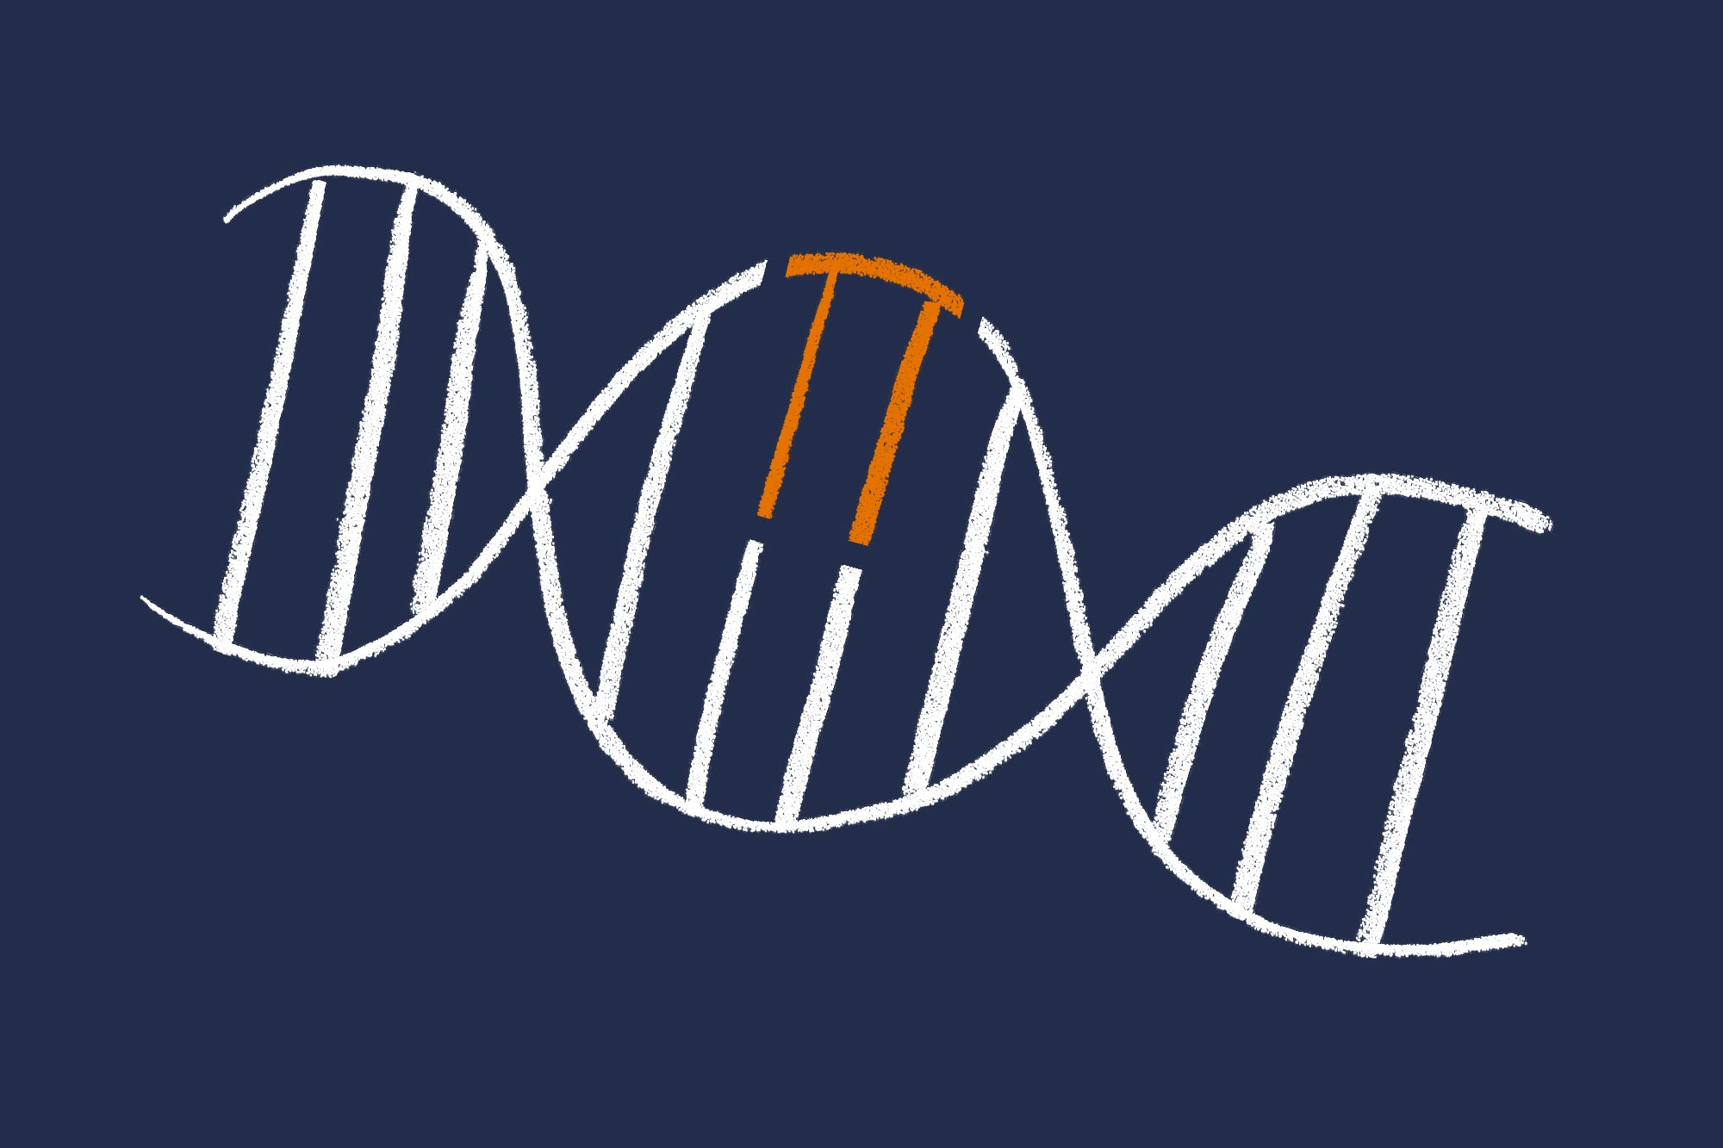
Mutations
When the DNA changes as a result of mutations, the code it makes also changes.
This sometimes leads to new affects, both positive or negative (mostly negative).
Any change to the DNA nitrogenous base code is called a mutation.
Mutations can be caused naturally, by our cells making mistakes when dividing, or by things in our environment.
Anything that causes mutations is called a mutagen. Examples of mutagens are uv radiation, microwaves, and chemicals like formaldehyde.
Mutagens that typically cause cancer, like asbestos are called carcinogens

Slide 12
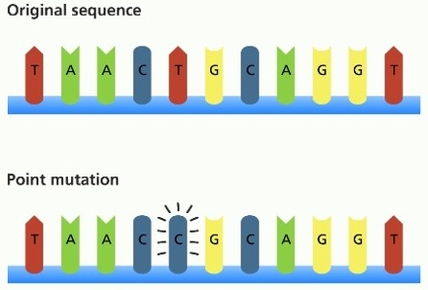
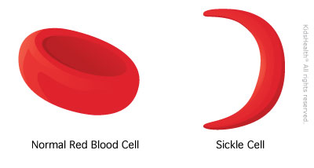
Mutation Types - Substitution
There are many types of mutations. The following are a list of common mutations.
Substitution/point mutation – When a single base pair is changed to a different one.
Example condition: Sickle cell anemia is when red blood cells are no longer circular and have a harder time moving oxygen. Leads to out-of-breath feeling
Sickle cell anemia's condition is caused by a point mutation that changes the amino acid valine to a glutamate.

Slide 13
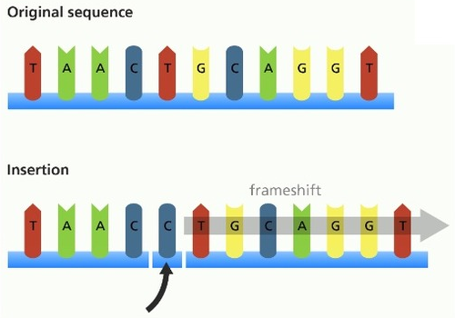
Mutation Types - Insertion
Insertion mutations are very dangerous. They add some base pairs to the sequence.
This often throws off the rest of the sequence, as it "bumps" each letter one place over.
When this "bumping" of the letters happens, it is called a frameshift mutation, because the three base reading frame is now off.
This means the amino acid sequence is often completely changed in the rest of the protein, unless a multiple of three base pairs were added.

Slide 14
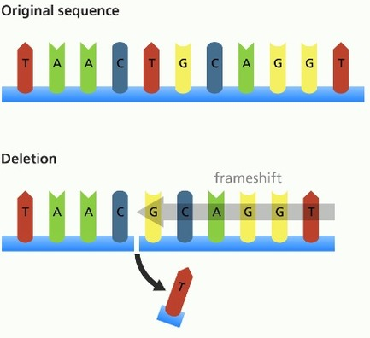
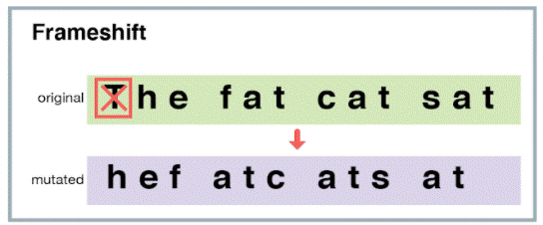
Mutation Types - Deletion
Deletion mutations are very dangerous. They remove some base pairs in the sequence.
Once again, it can often change the rest of the sequence by causing a frameshift mutation.
Insertion and deletion mutations have a nasty habit of breaking proteins entirely, as they can change a lot, including where the stop codon is.

Slide 15
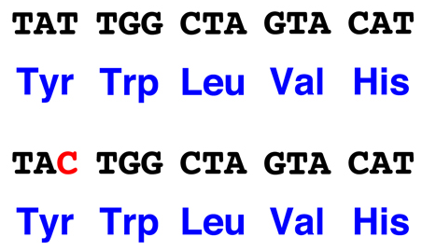
Mutation Types – Silent Mutation
Silent mutations change the DNA base pair code, but do not cause a major change to the amino acid code.
This is because the code has multiple codes for the same amino acid, and because many amino acids can work in place of each other (Back Up Plan).
Silent mutations are safe, as nothing major happens to the proteins.

Slide 16
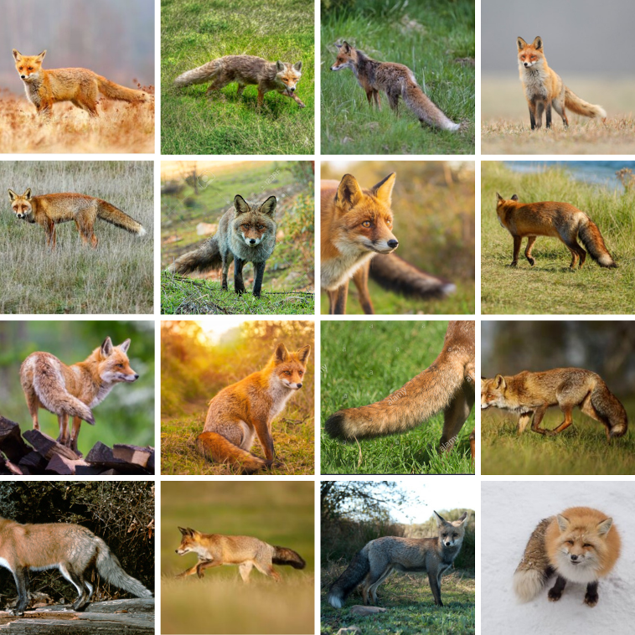
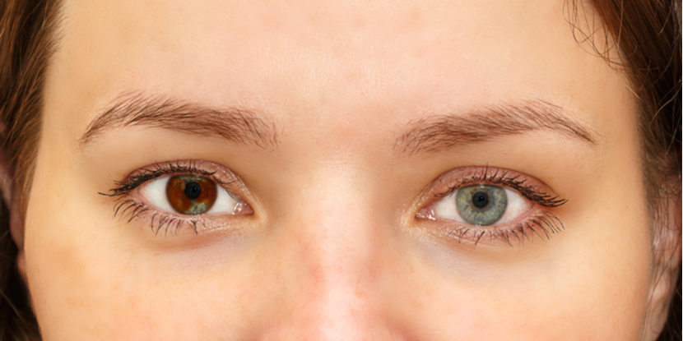
Good Mutation Example
While most mutations are typically bad, some can have positive affects
Examples of good changes:
HIV resistance
Lactose tolerance
A fox changing fur colour to better blend in
Increase in fat production in a cold region
An example of a mutation that is not good or bad is heterochromia (two different eye colours.

